Slide 1
Maker Club
Notes:
IDEAS is not 508 compliant but the full name of IDEAS which is below is 508 compliant on dark blue. Black type on the IDEAS green is 508 compliant.

Slide 2
GOAL OF THE MAKER CLUB:
Learn how to create 3D objects and designs using the Engineering Design Process
Notes:
White type on darker shade of IDEAS blue is 508 compliant

Slide 3
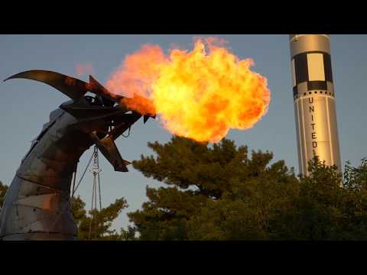
What is the “Maker Movement”?

Slide 4
BRAINSTORM
IDEAS
MAKE A
PLAN
START
IDENTIFY
THE
PROBLEM
PROTOTYPE
FAILS
MAKE YOUR
PROTOTYPE
ITERATION
IMPROVE
OR
FINALIZE
TEST YOUR
PROTOTYPE
Notes:
Redid EDP chart in PPT so it is editable and clearer on screen. Should the colors be changed to be 508 compliant?

Slide 5
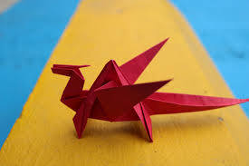
ONE SHEET OF PAPER
15-20 minutes

Slide 6
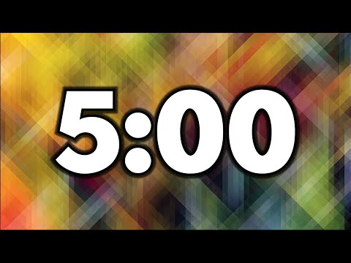
One Sheet of Paper
Materials needed: 1 piece of paper
Make a 3D object using your paper
We will compare our designs in 5 minutes
Let’s do it!

Slide 7
Let’s share our 3D designs!
Tell us:
What you made
How you made your 3D object
What makes this creation a 3D object

Slide 8
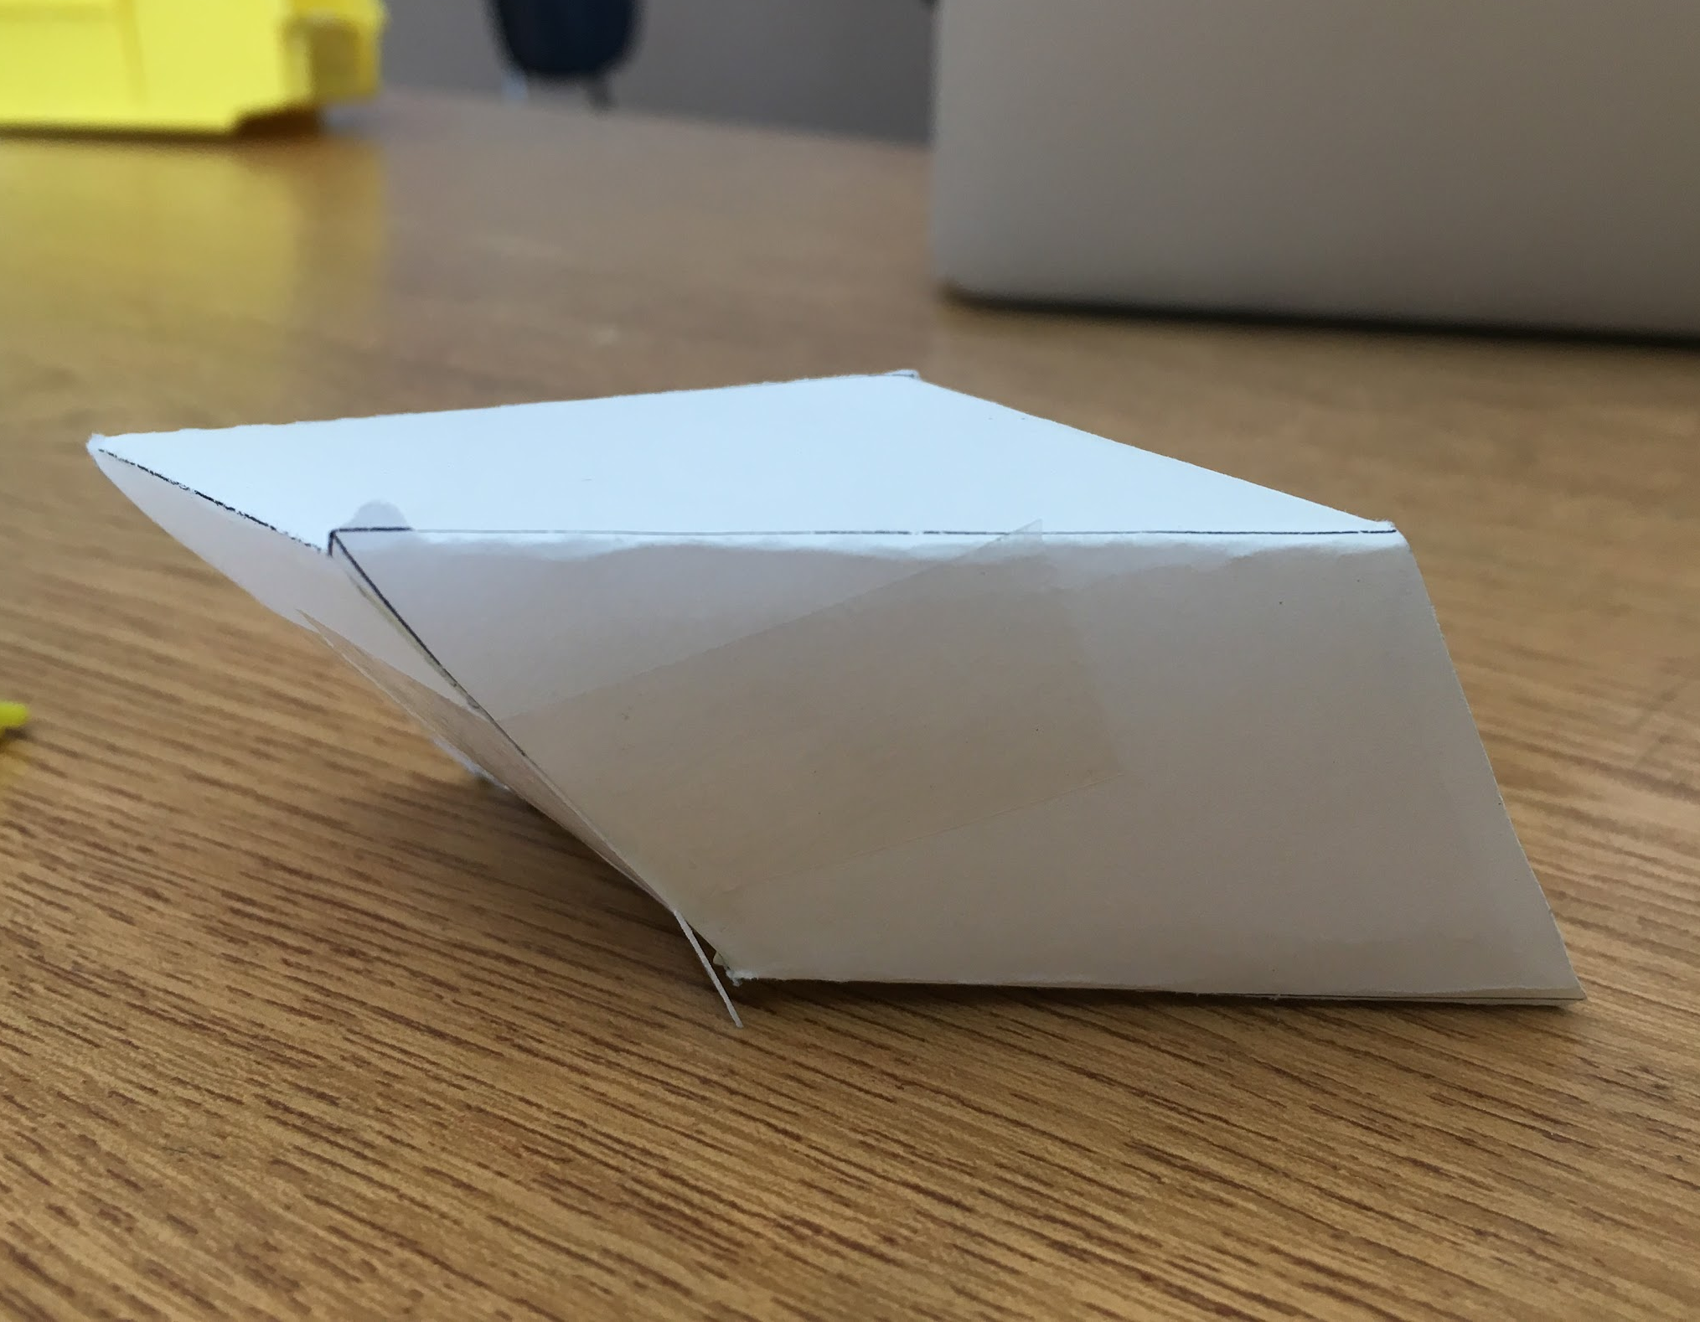
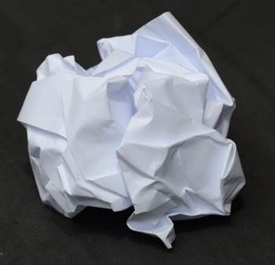
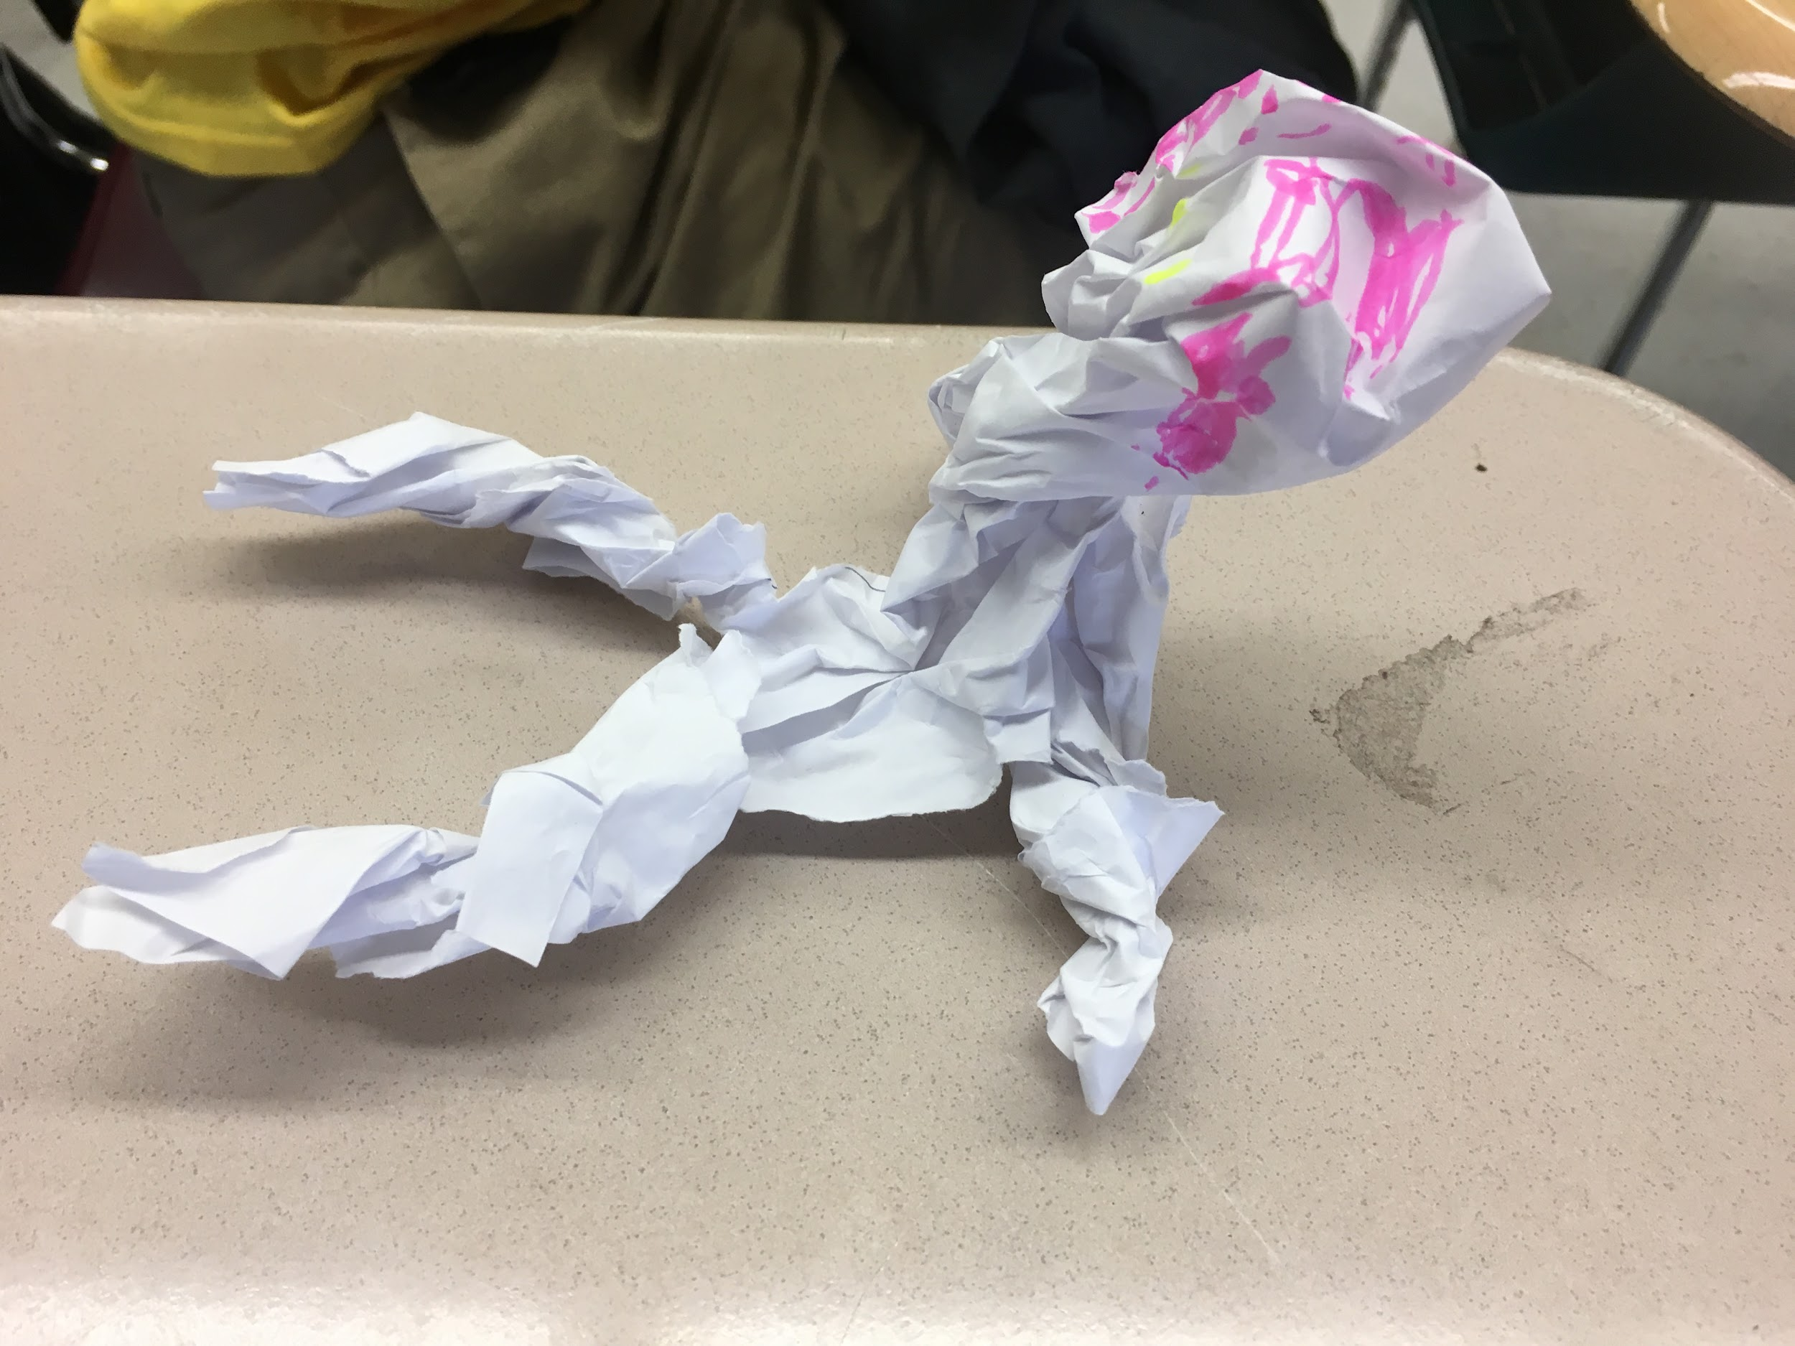

Slide 9
Brainstorm
What comes to mind when you think of an engineer?

Slide 10
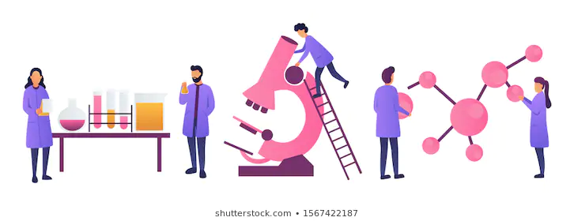
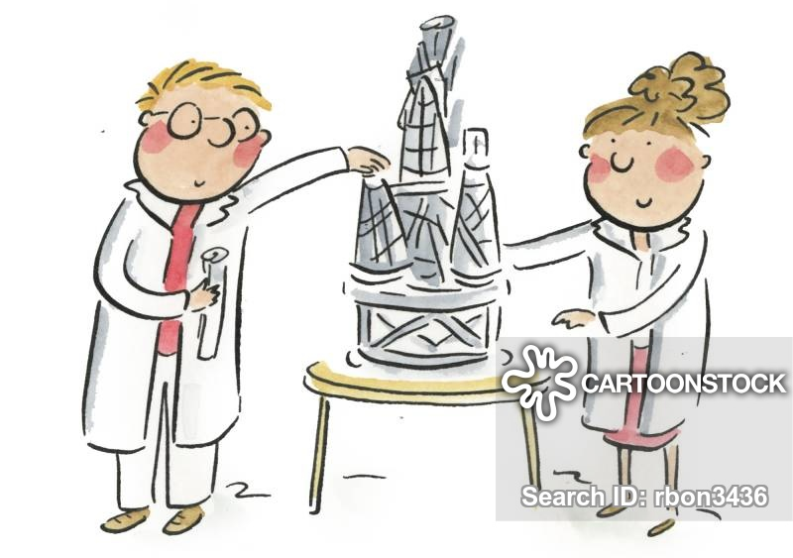
Engineers design objects that help solve problems or challenges that people have. They design things from buildings and bridges to computers and apps!

Slide 11
BRAINSTORM
IDEAS
MAKE A
PLAN
IDENTIFY
THE
PROBLEM
START
PROTOTYPE
FAILS
MAKE YOUR
PROTOTYPE
ITERATION
IMPROVE
OR
FINALIZE
TEST YOUR
PROTOTYPE

Slide 12
Explore your surroundings
5 minutes
Take 5 minutes to look around.
What can you find that has been “engineered” or “designed”?
Take a picture, draw or bring the item back to share!
Notes:
Option with free Youtube video timer placed. You would need to use video timers because there are not animated gifs that countdown like this. It seems like there are a lot of time options in this same format so teachers can pick and choose. Video created by Adam Eschborn
.

Slide 13
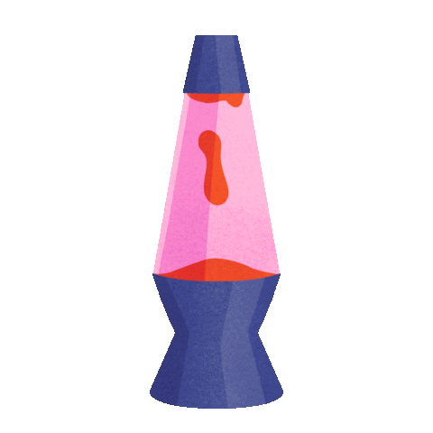
Let’s share our objects
?
How do you know this object was engineered?
What did the engineer consider when designing it?
What’s something you have a lot of in your home (forks, lamps, chairs etc.)?
Does every version look the same? What’s similar, what’s different?
?
?
?
Notes:
Example of how to use free animated gifs if that is definitely ok.

Slide 14
We will use these materials next time:
Cardstock or colored paper
5-10 sheets of plain paper
Something to make holes (optional)
Hammer and 1 nail
Hole puncher
Scissor
String, thread, or yarn
Crayons, markers, stickers, or other craft supplies
Notes:
Thinking I will create icons for the 7 maker activities that can be reused if you think that is something that you would like instead of animated gifs.

Slide 15
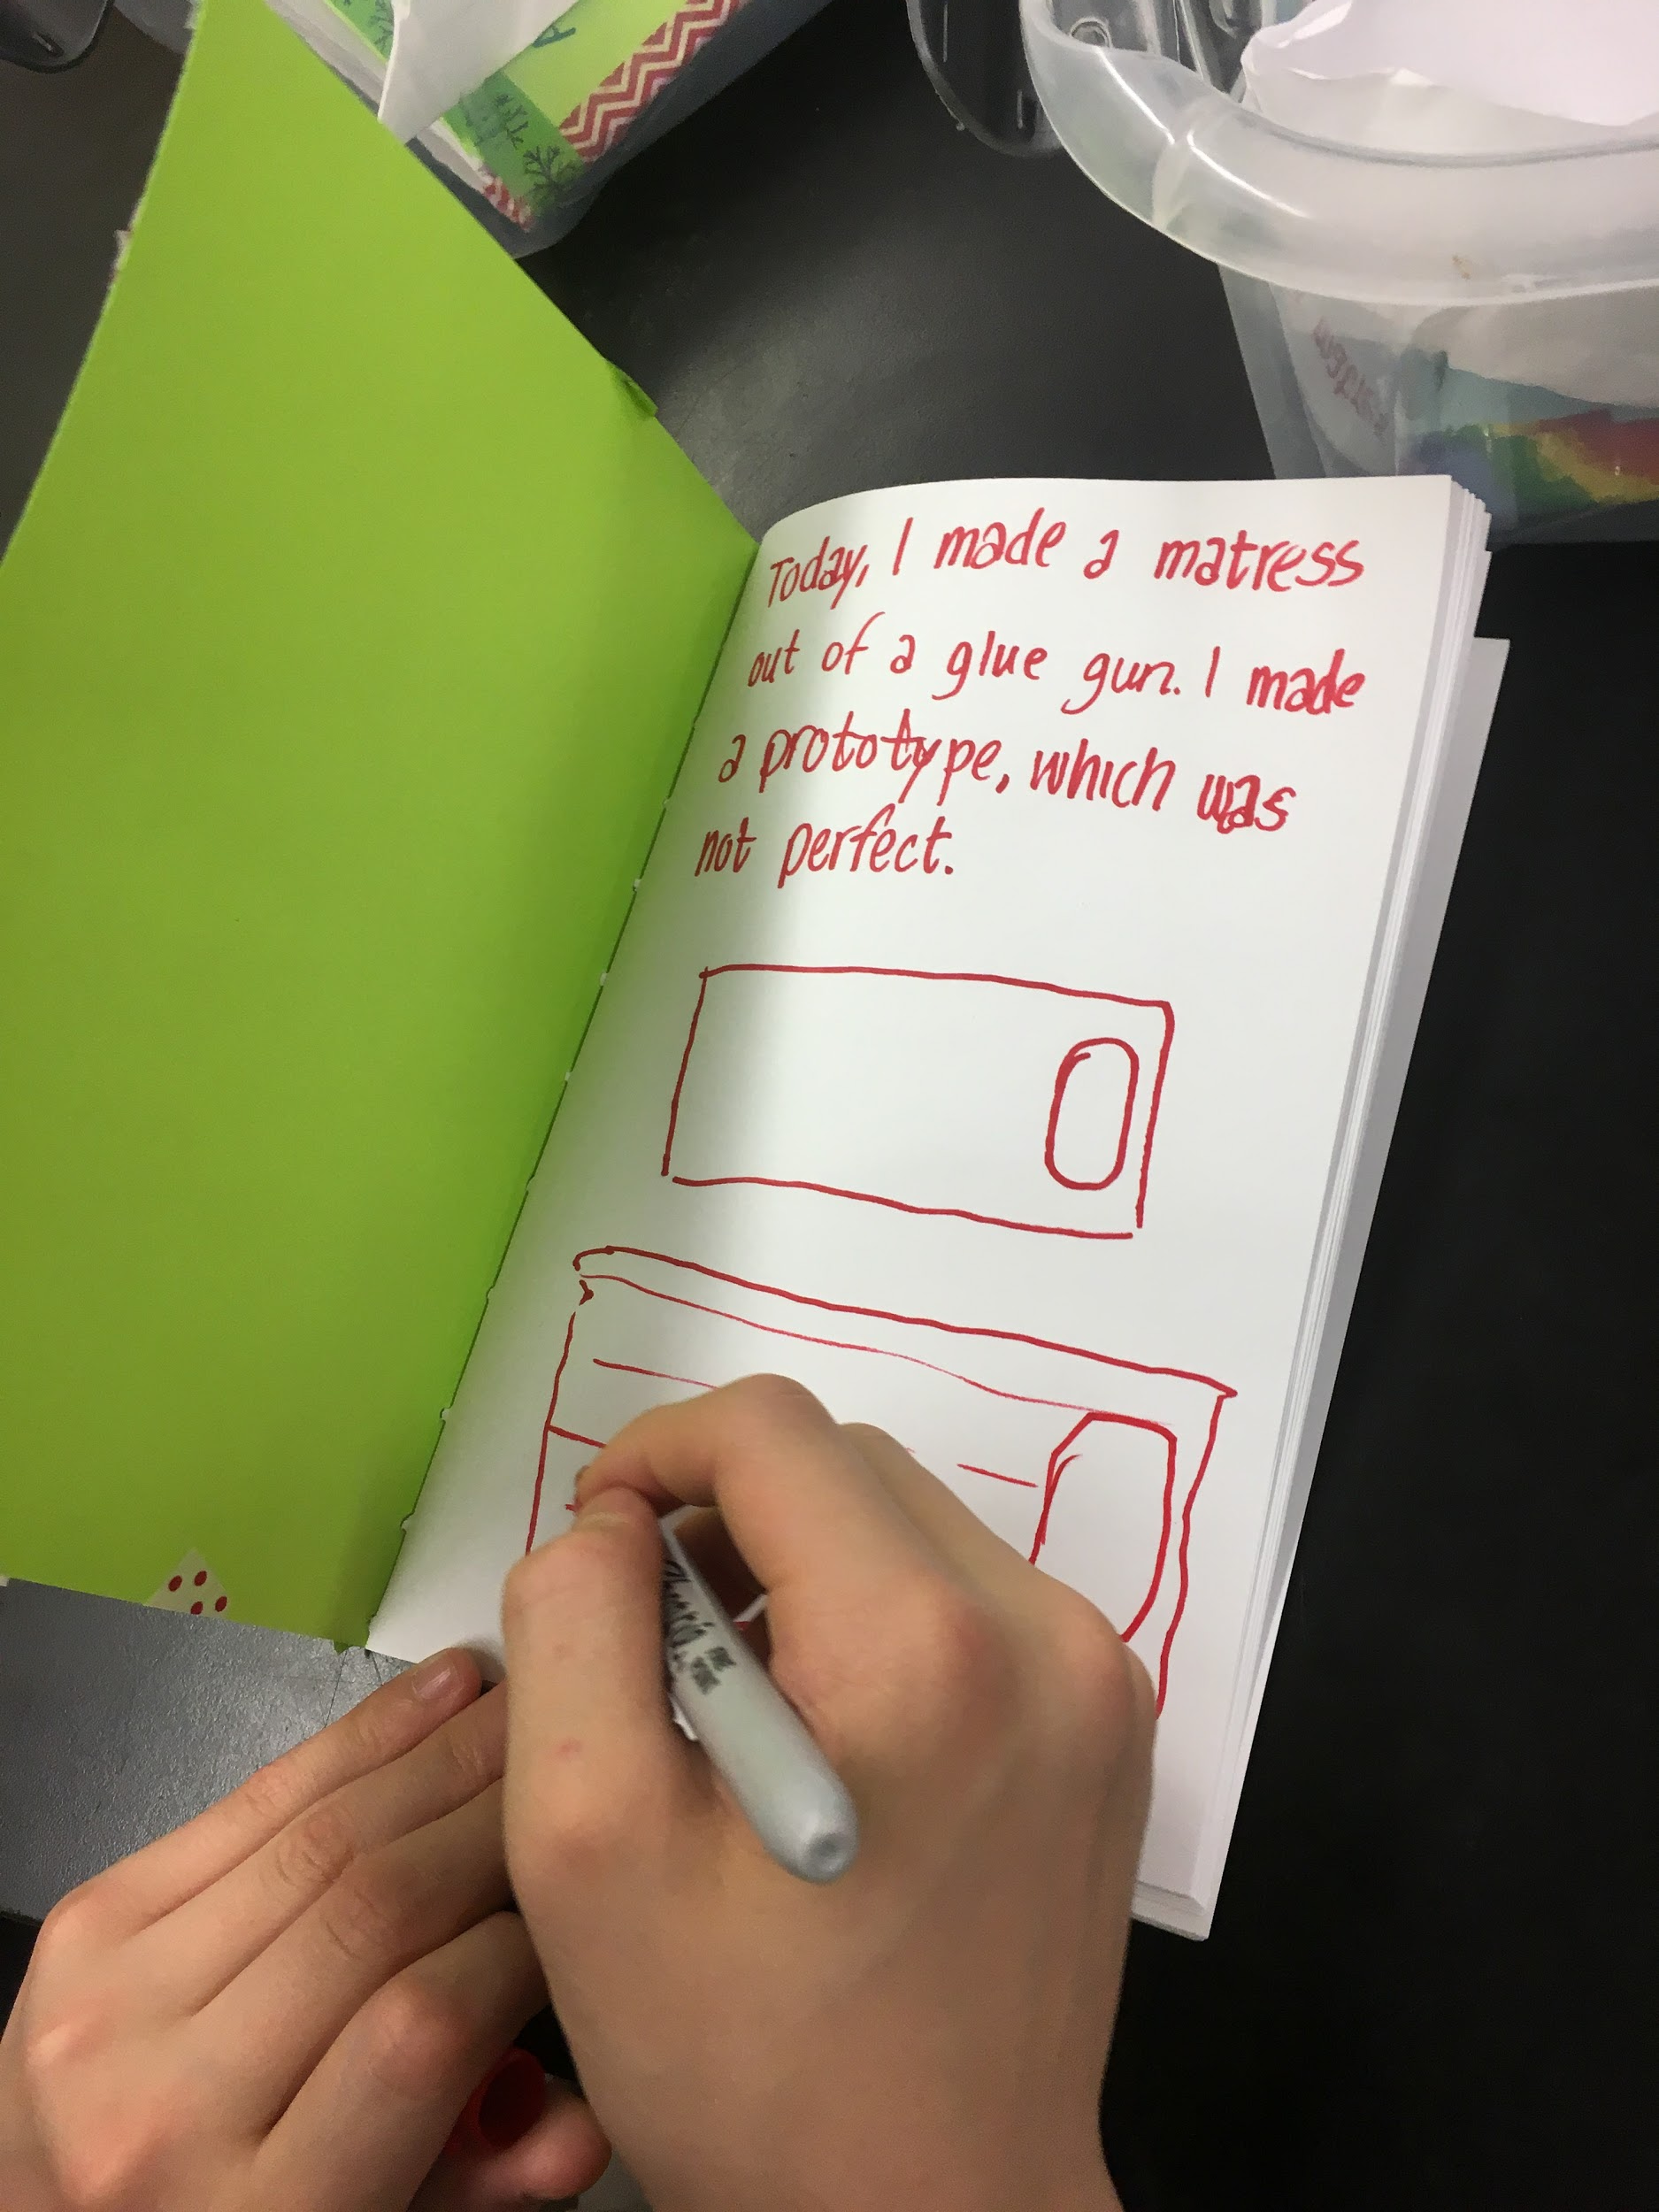
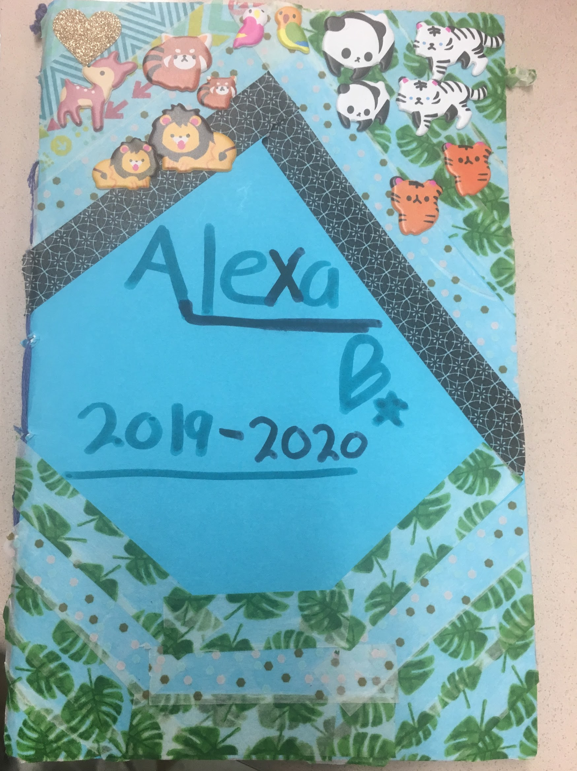
JOURNAL MAKING
45 minutes-1 hour

Slide 16
Key Vocabulary
Documentation: The process of taking notes about something
Binding: The holding together of pages
Sewing: Attaching together with a needle and thread
Hammer: A tool with a metal head used with nails
Needle: A skinny piece of metal with a point on one end and hole on the other, used for sewing

Slide 17
Reflect
?
What we did we do last time in Maker’s Club?
What tools or materials did we use?
What did we make?
?
?

Slide 18
How can we keep track of our ideas?
BRAINSTORM
IDEAS
MAKE A
PLAN
START
IDENTIFY
THE
PROBLEM
PROTOTYPE
FAILS
MAKE YOUR
PROTOTYPE
ITERATION
IMPROVE
OR
FINALIZE
TEST YOUR
PROTOTYPE
Notes:
Black text on orange is 508 compliant. Circle will turn orange for section of EDP chart that you are on in additional slides.

Slide 19
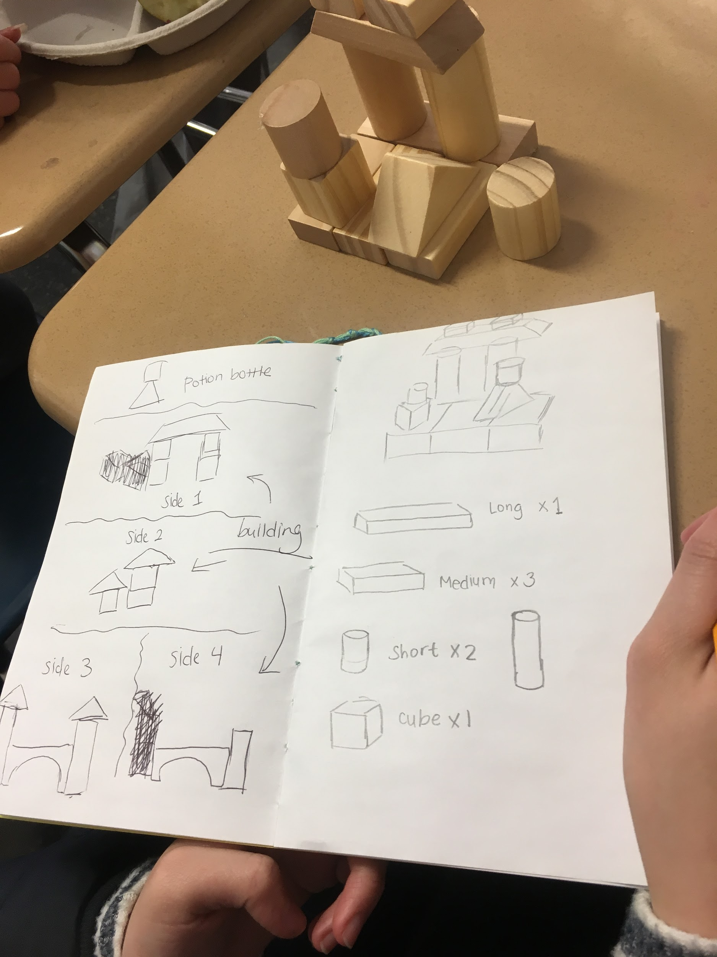
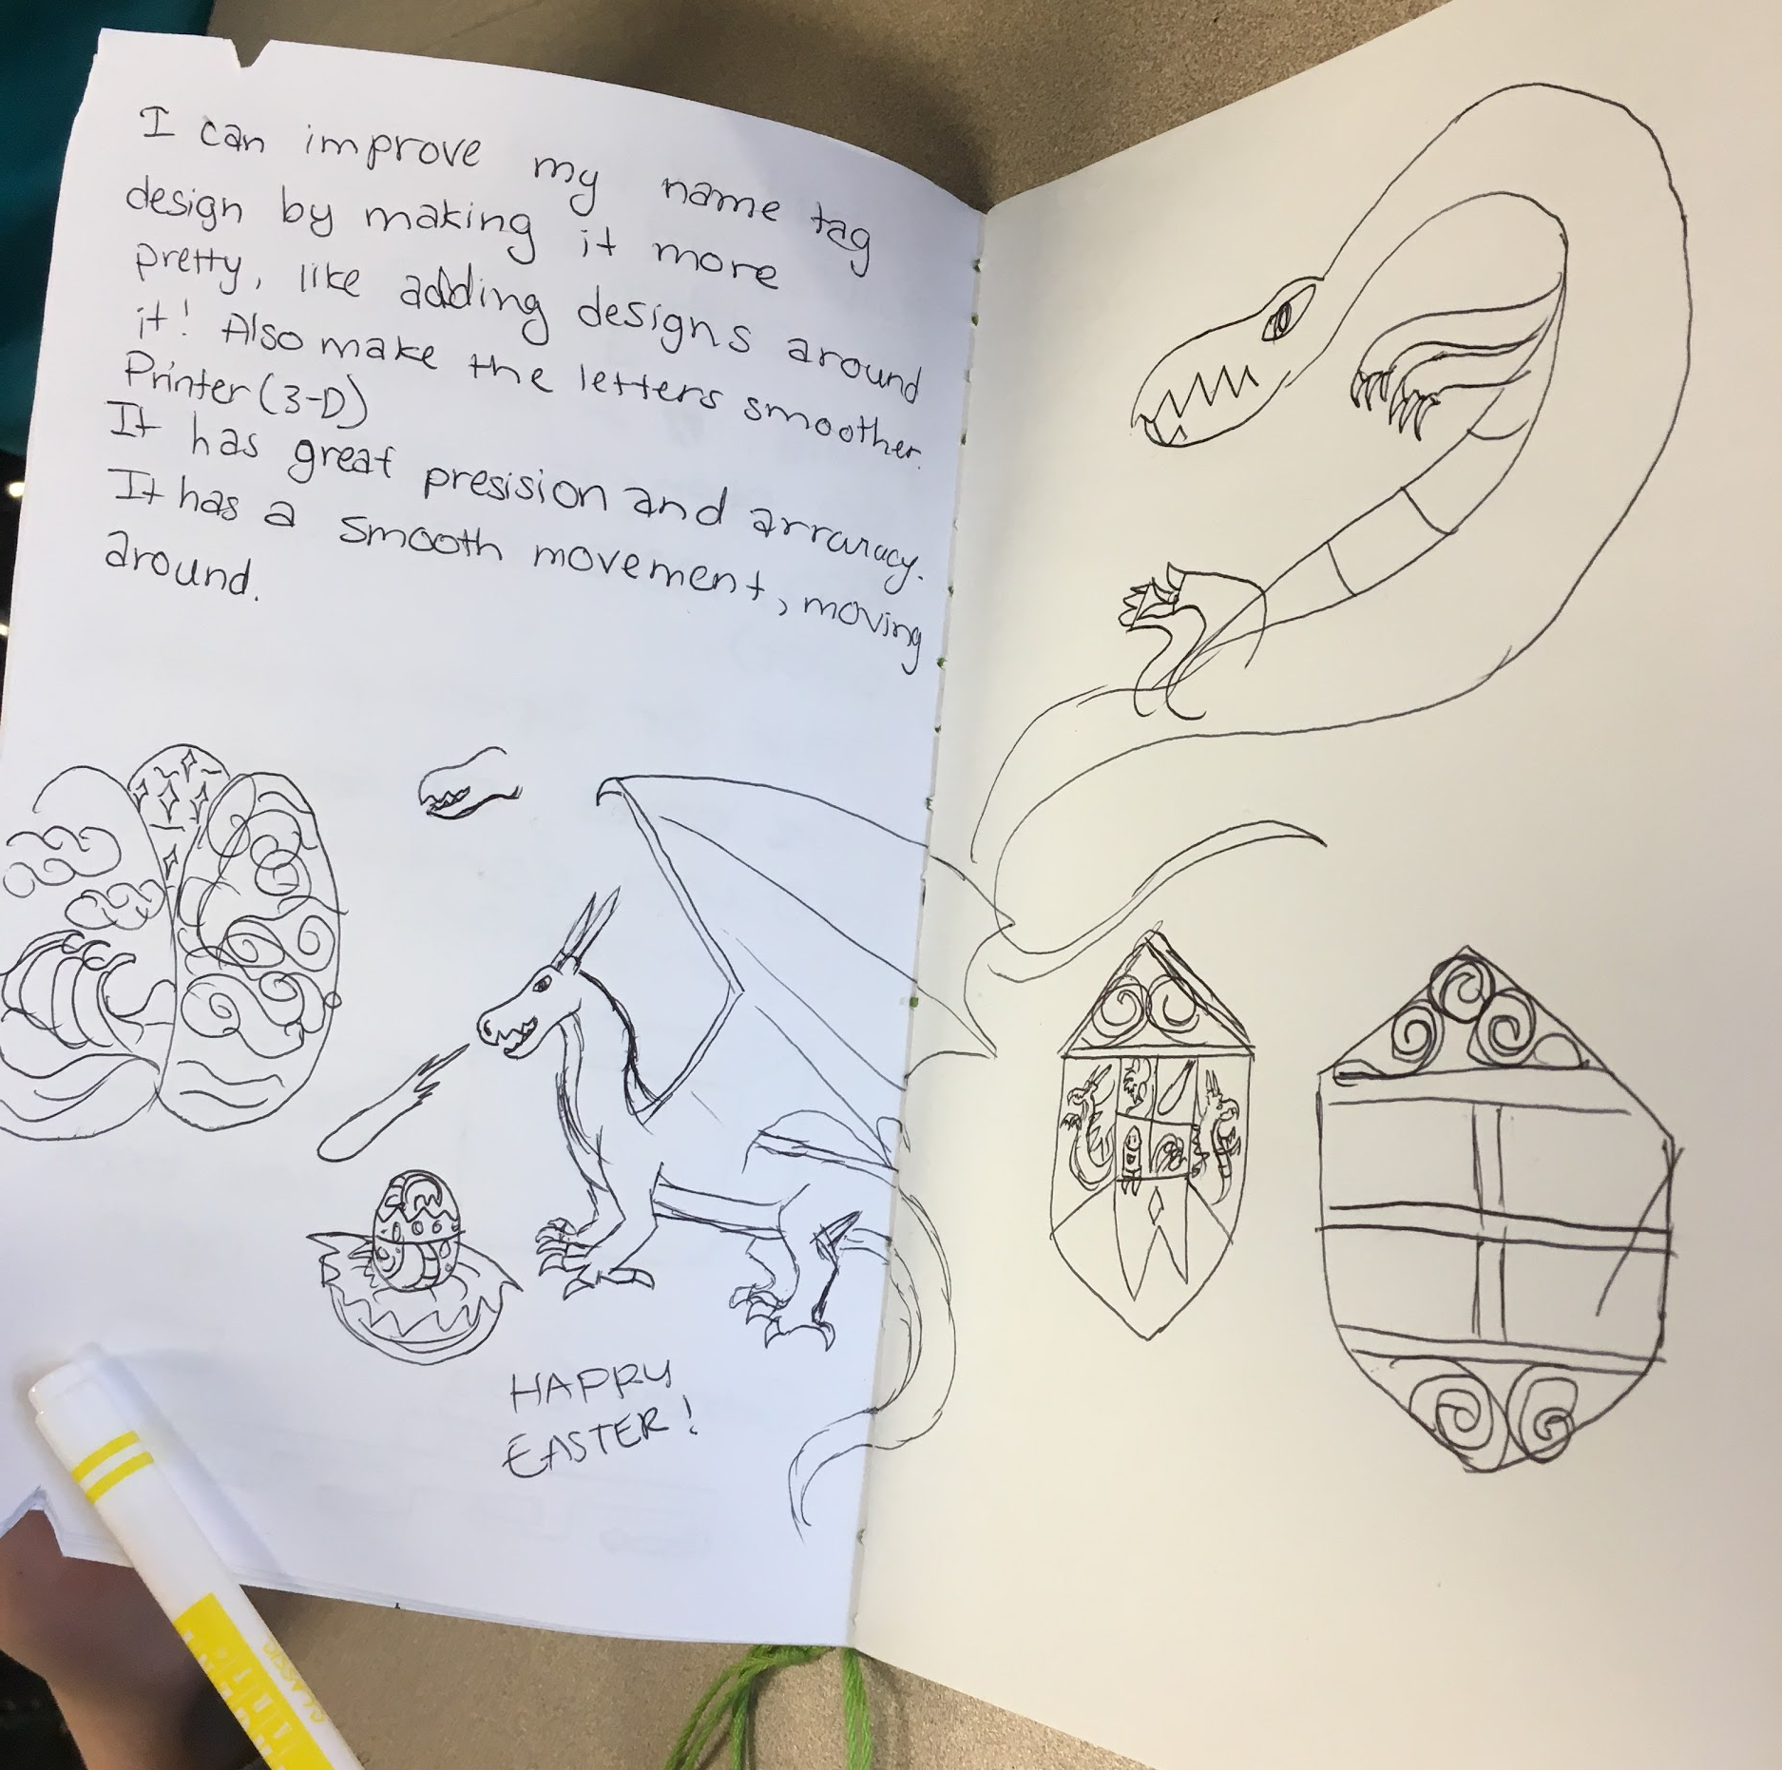
Journals
?
What is a journal?
Why do people use journals?
In Maker Club, we will use our journals to share and record our projects.
?

Slide 20
Materials
Cardstock or colored paper
5-10 sheets of plain paper
Something to make holes (optional)
Hammer and 1 nail
Hole puncher
Scissors
String, thread, or yarn
Crayons, markers, stickers, glue, beads, buttons or other craft supplies

Slide 21
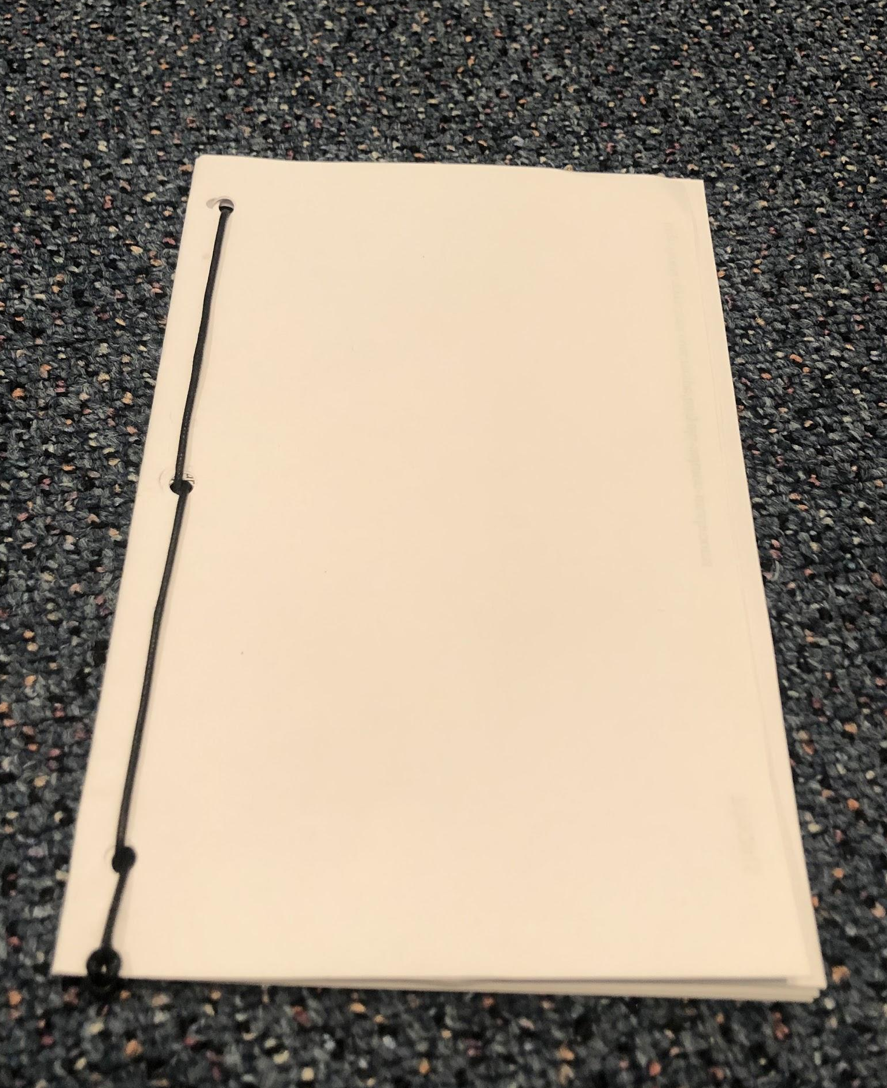
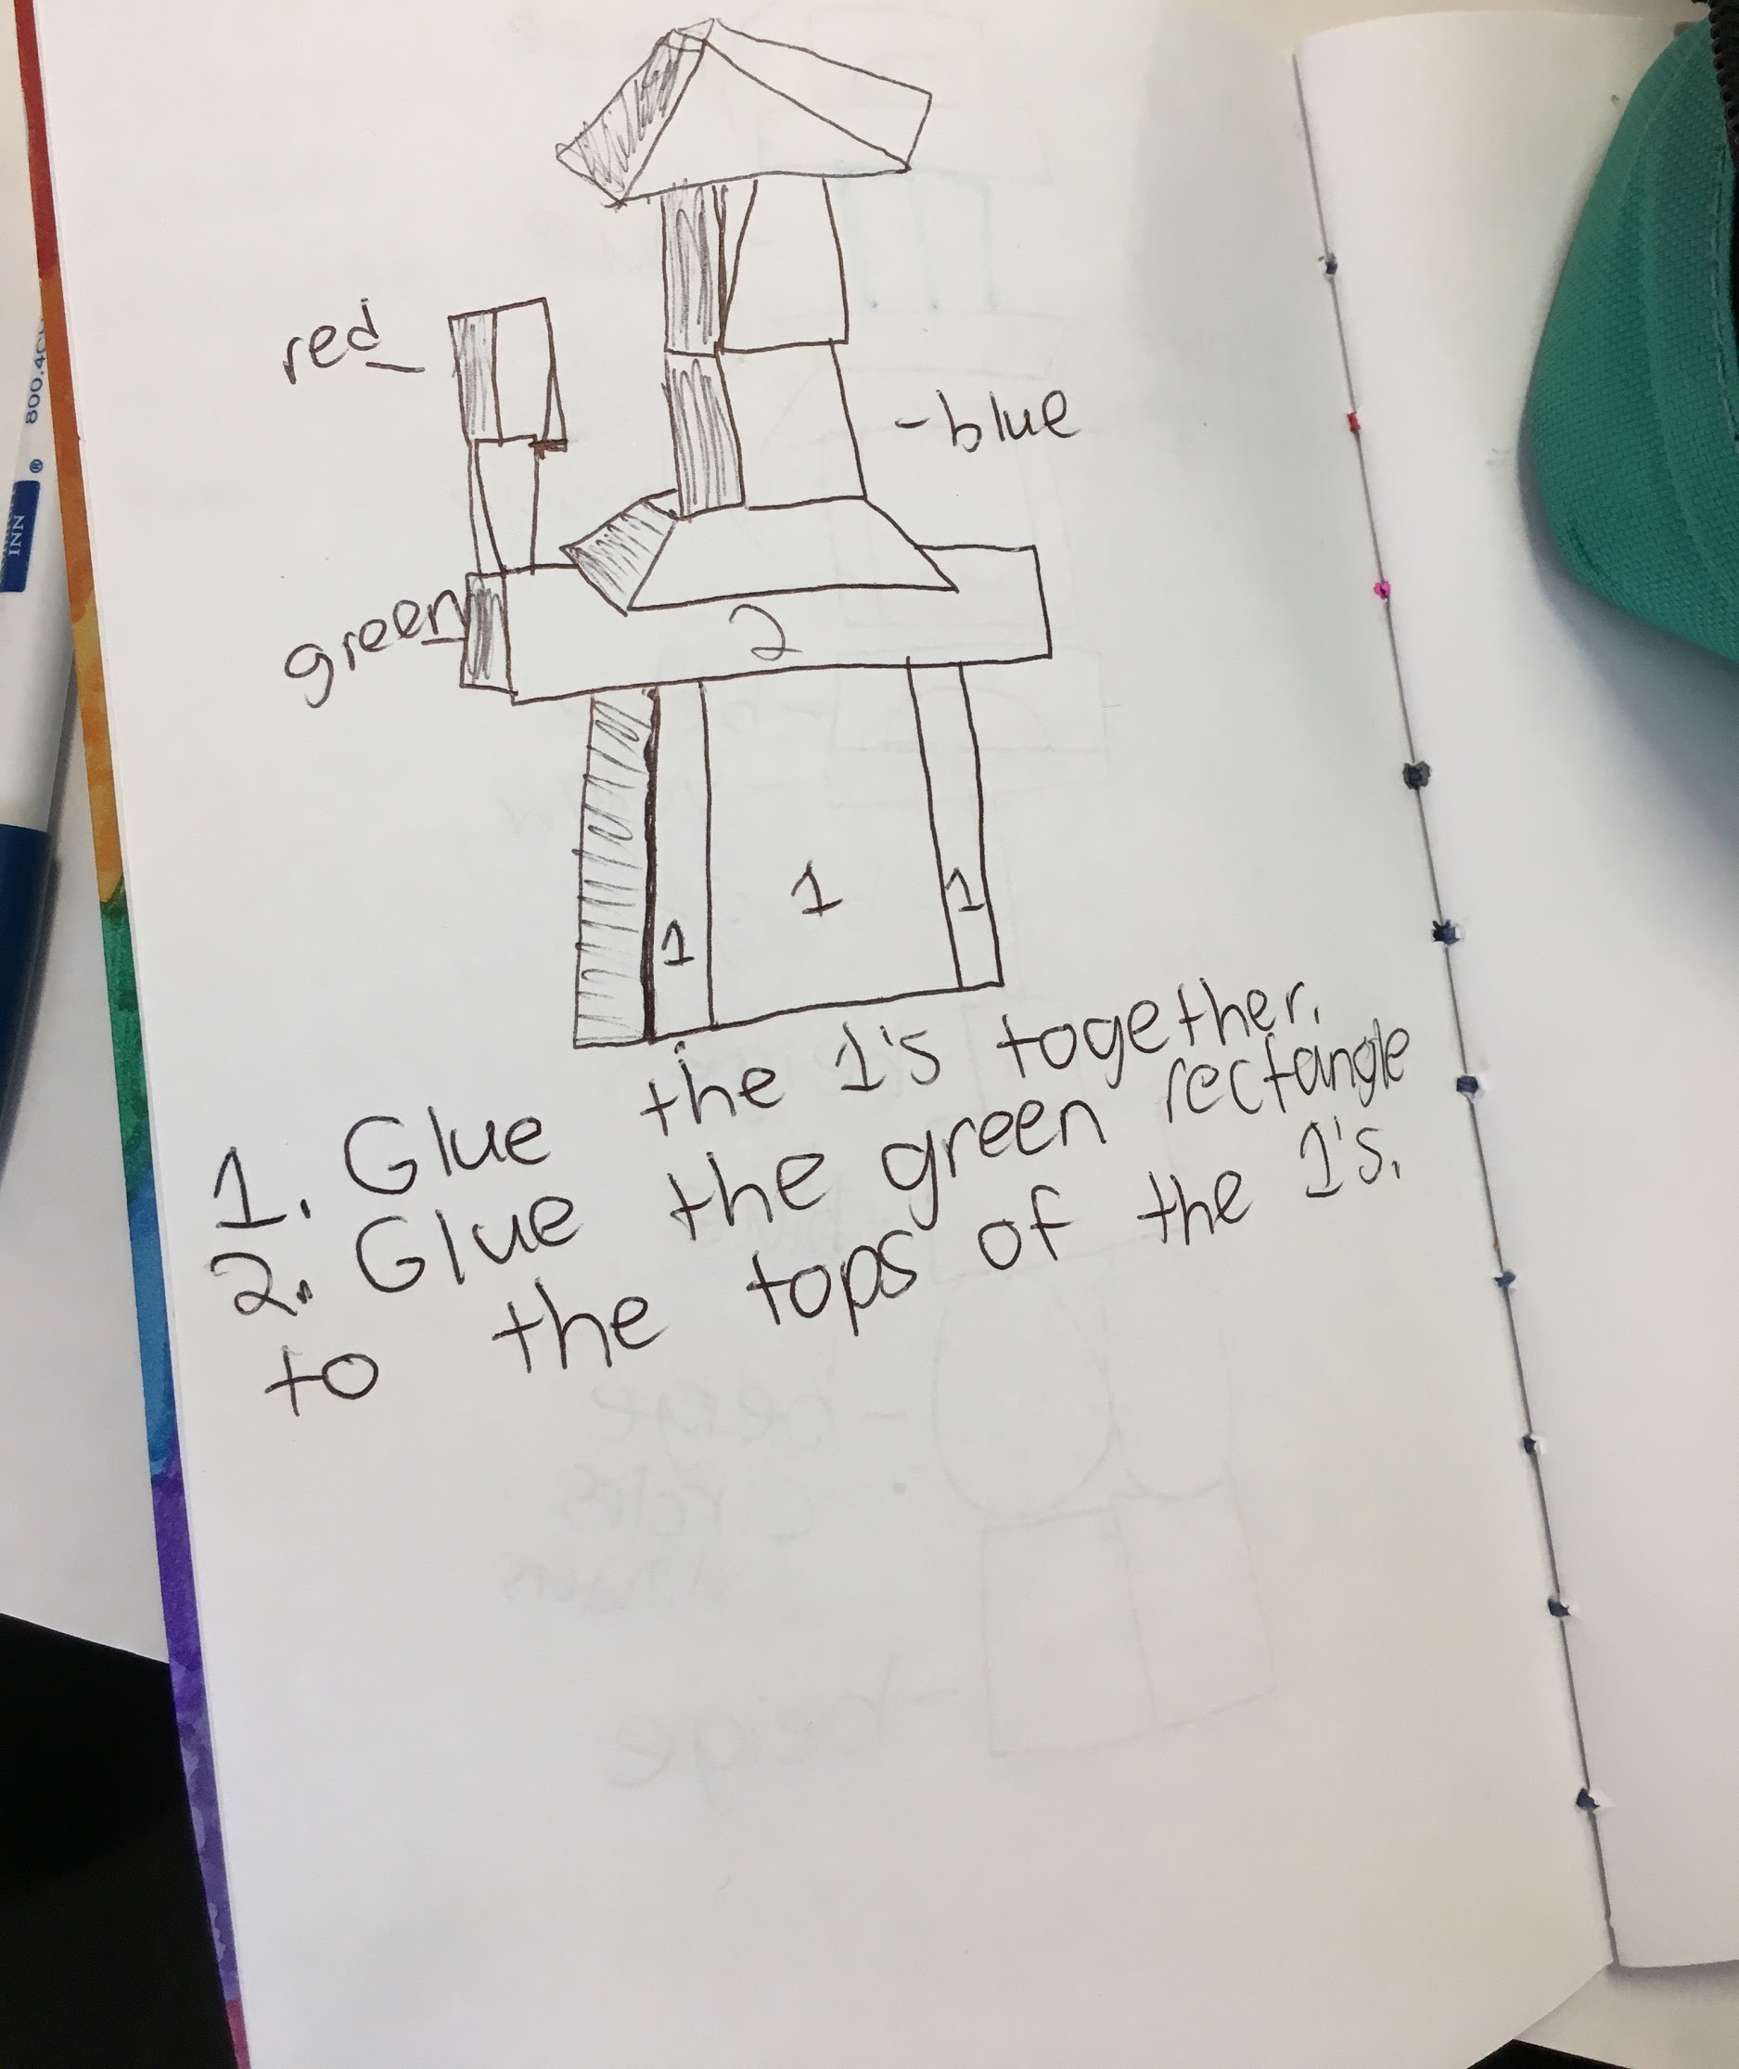
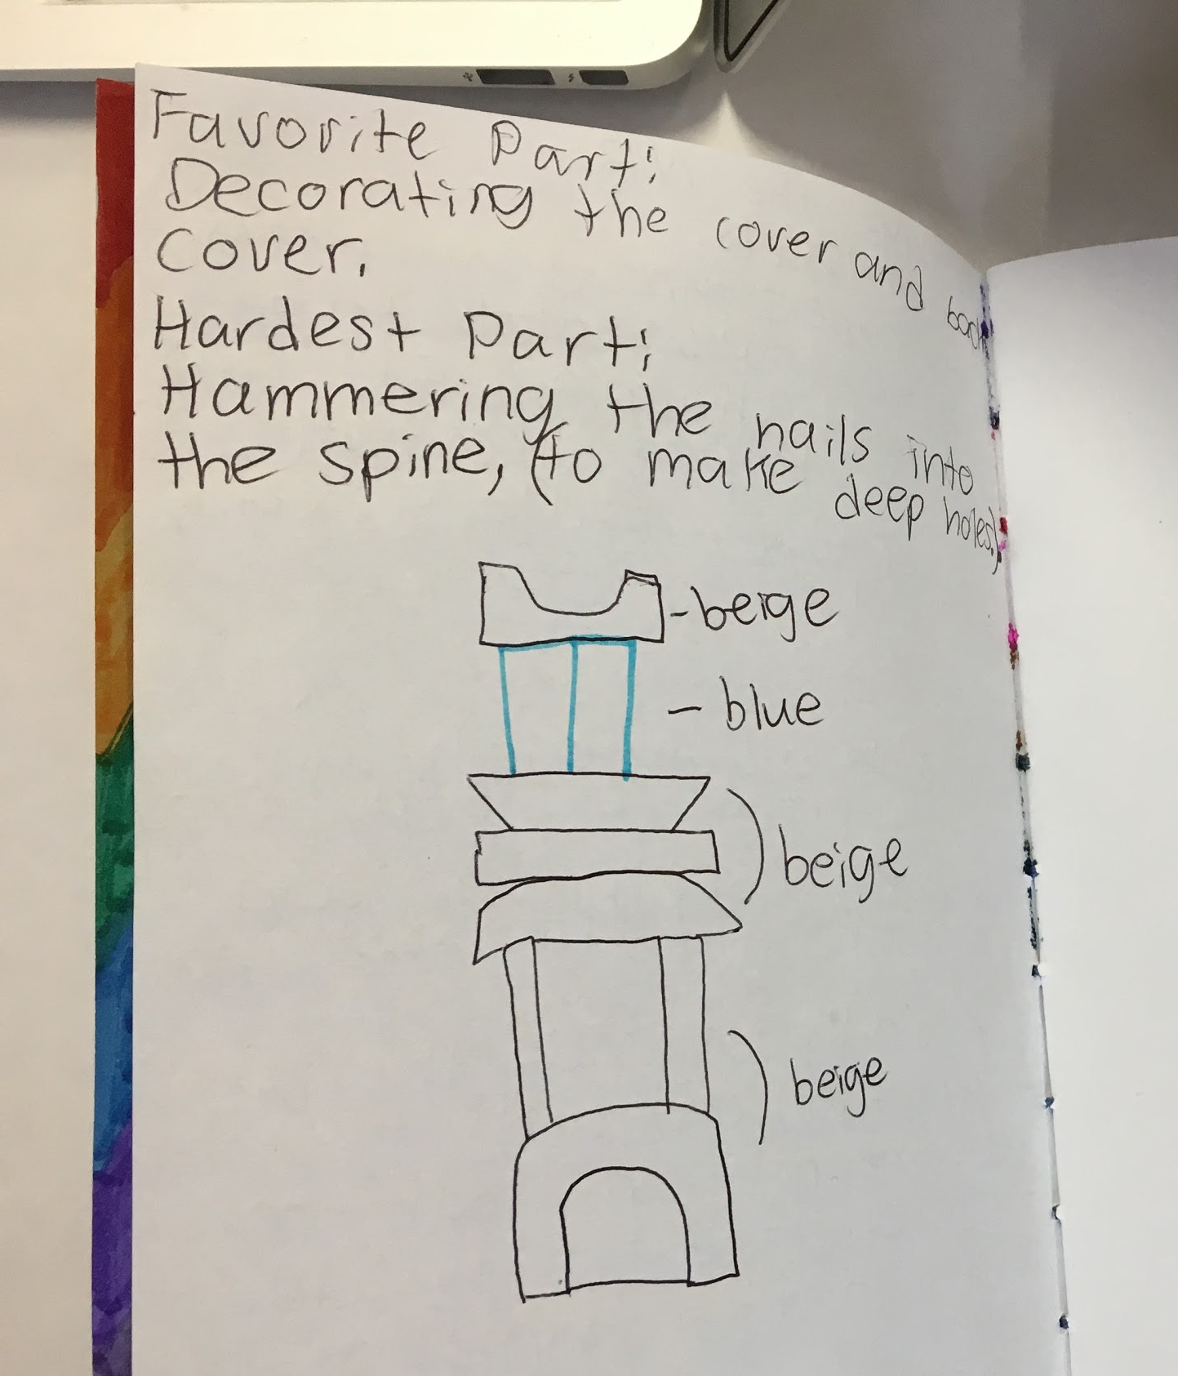
How can we make a journal?
?
What materials can we use to make a journal?
How can we put these materials together to create a book?
BRAINSTORM
IDEAS
MAKE A
PLAN
?
START
IDENTIFY
THE
PROBLEM
PROTOTYPE
FAILS
MAKE YOUR
PROTOTYPE
ITERATION
IMPROVE
OR
FINALIZE
TEST YOUR
PROTOTYPE
Notes:
Black text on orange is 508 compliant. Circle will turn orange for section of EDP chart that you are on in additional slides.

Slide 22
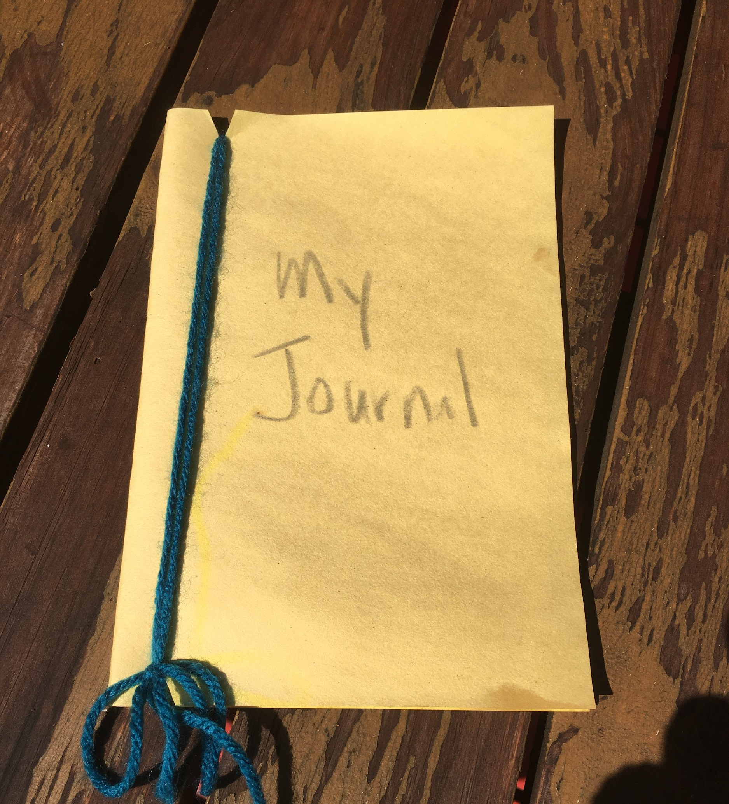
Journal Binding Method #1
Wrap Binding
How do you think you can make a wrap binding?
What materials do you need?
Steps:
Remember: this is just an example! You can use the method you think is best!

Slide 23
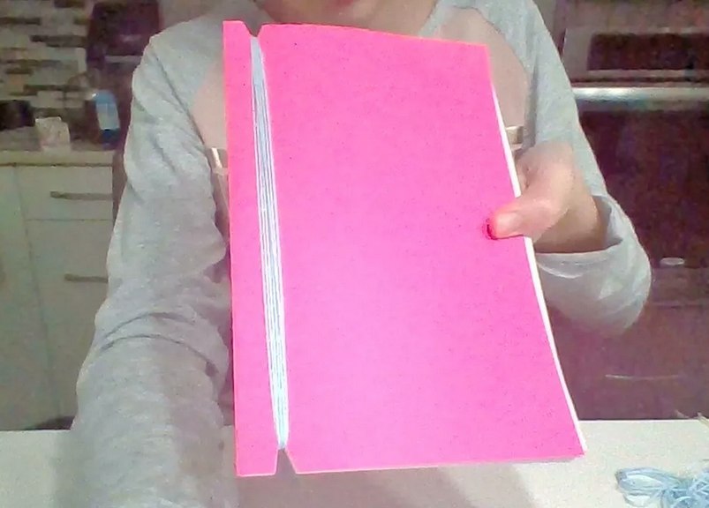

Slide 24
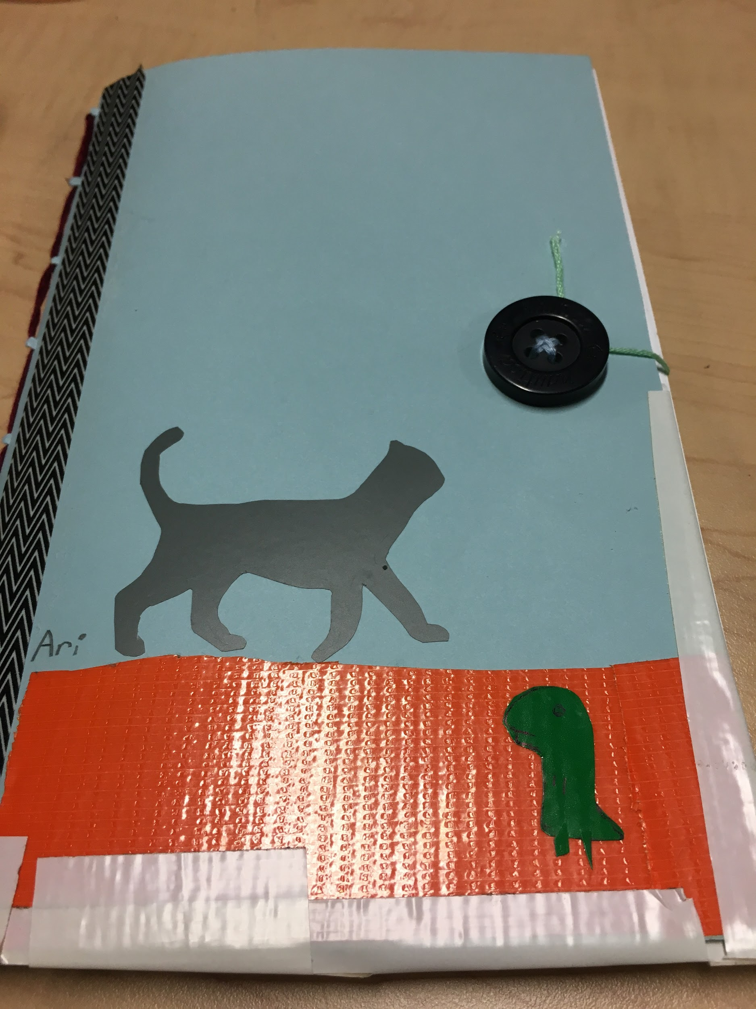
Journal Binding Method #2
Sew Binding
How do you think you can make a sew binding?
What materials do you need?
Steps:
Remember: this is just an example! You can use the method you think is best!

Slide 25
Journal Binding Method #3
Other possibilities?
What other materials or methods can you use to make a journal?
Steps:

Slide 26
Let’s Make Our Journals!
BRAINSTORM
IDEAS
MAKE A
PLAN
?
What materials will you use to make a journal?
Which type of binding will you select?
START
IDENTIFY
THE
PROBLEM
PROTOTYPE
FAILS
MAKE YOUR
PROTOTYPE
?
ITERATION
IMPROVE
OR
FINALIZE
TEST YOUR
PROTOTYPE

Slide 27
Share and reflect
?
What did you like about this activity?
How did you find your materials?
Why did you choose your materials?
Are there materials you wish you had?
?
?
?

Slide 28
BRAINSTORM
IDEAS
MAKE A
PLAN
IDENTIFY
THE
PROBLEM
START
PROTOTYPE
FAILS
MAKE YOUR
PROTOTYPE
ITERATION
IMPROVE
OR
FINALIZE
TEST YOUR
PROTOTYPE

Slide 29
Write in your journals...
What was your process for making your journal?
Which parts of the engineering design process did you use?
Record the materials you used and how you used them.
Tape the picture of the EDP to your back cover to remind you of the steps when you write in your journal.

Slide 30
We will use these materials next time:
Glue
Play-Doh
LEGOs
Construction paper
Cardboard
Anything else that you can stack/layer
Notes:
Thinking I will create icons for the 7 maker activities that can be reused if you think that is something that you would like instead of animated gifs.

Slide 31
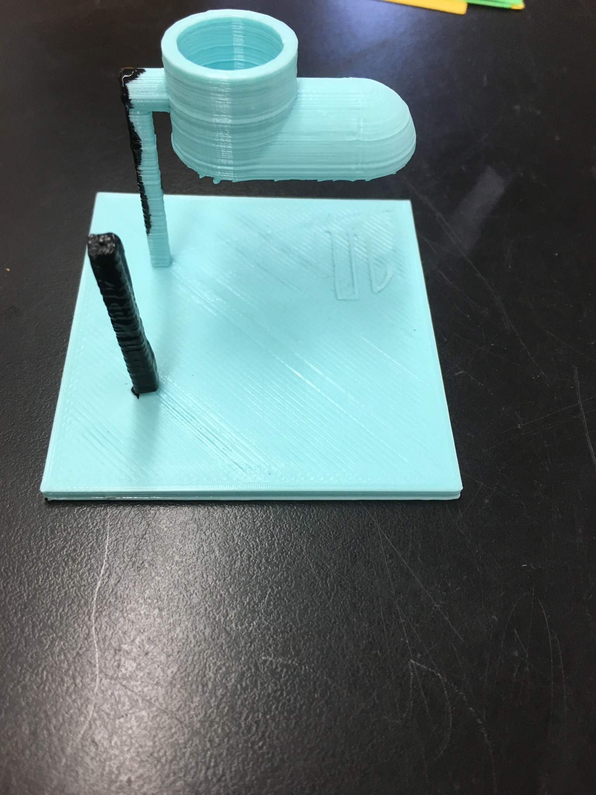
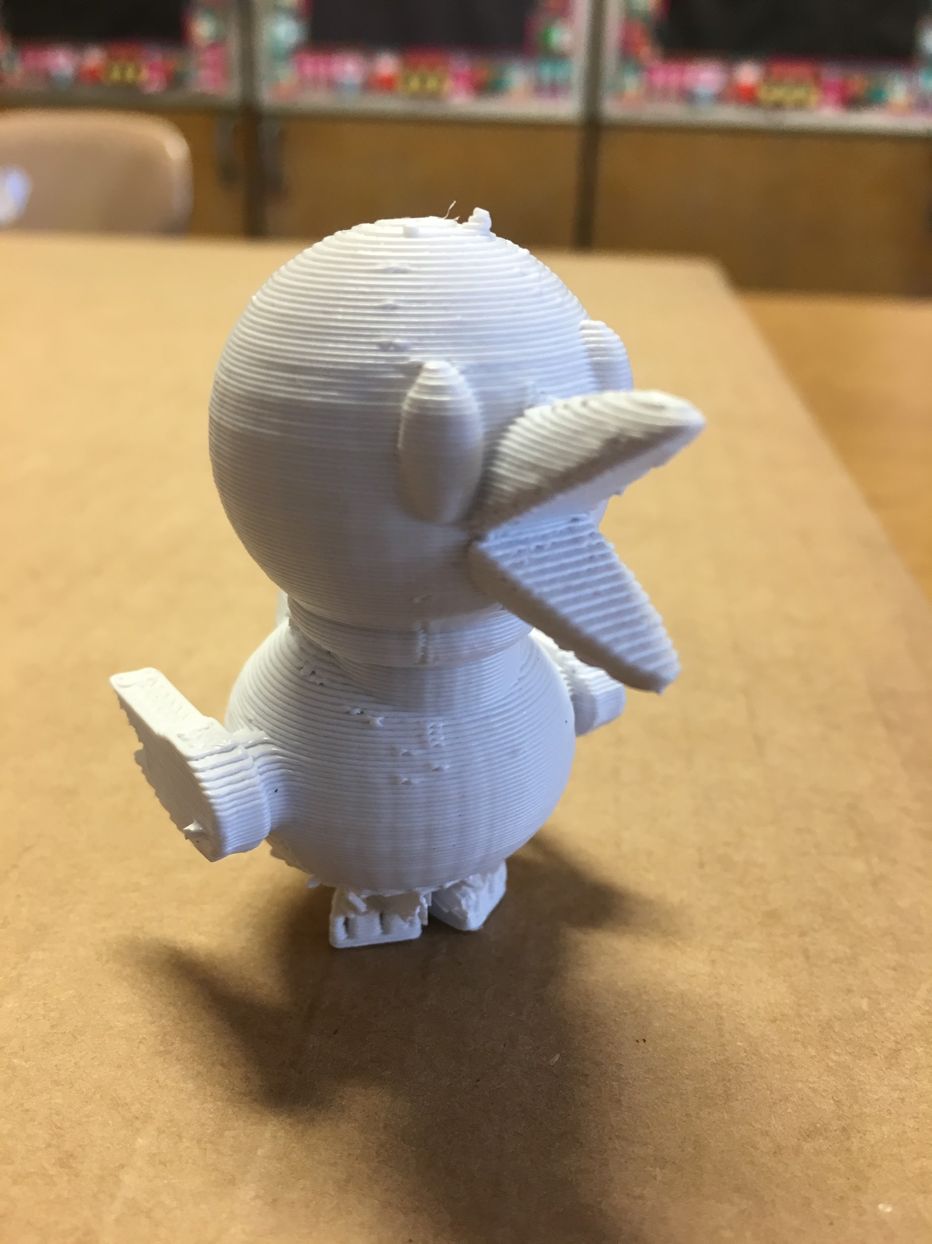
INTRODUCTION TO 3D PRINTING
Overall Time Needed?

Slide 32
Key Vocabulary
3D printing: The process of making an object from a 3D digital model, by laying down many thin layers of a material repeatedly
Layering: The thickness of a material laid down repeatedly; the process of making layers
Overhangs: A part of something that sticks out or hangs over another thing

Slide 33
Reflect
?
What we did we do last time in Maker’s Club?
What tools or materials did we use?
What did we make?
?
?

Slide 34
Intro to 3D Printing
Let’s watch some videos to see how 3D printers work:
Video 1
Video 2
Video 3
We will break into four groups and each group will watch a video and then tell us about it when we come back together.

Slide 35
Today we will make 3D sculptures
Reflect on the following questions:
What is a 3D printer?
What is a prototype?
?
?

Slide 36
What is a 3D printer?
3D printers are similar to regular printers, but instead of printing ink on a sheet of paper, they “print” or create 3D solids out of plastic.

Slide 37
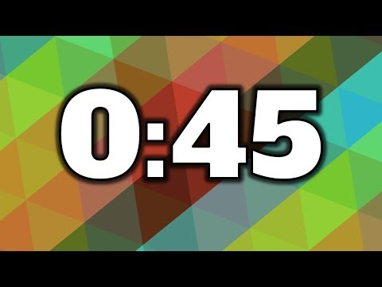
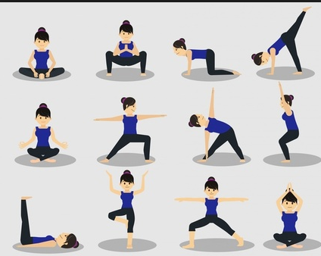
Understanding “Overhang”
Pick a position to hold for 45 seconds. Wait for timer!
What positions were difficult? Why?

Slide 38
What can we print on a 3D printer?
3D designs will not be able to hold their position for the same reasons we were not able to hold some of ours
Gravity
Holes
Overhang
How could you change your position to make a more successful print?
Hint: how can you add surface area and reduce overhang?

Slide 39
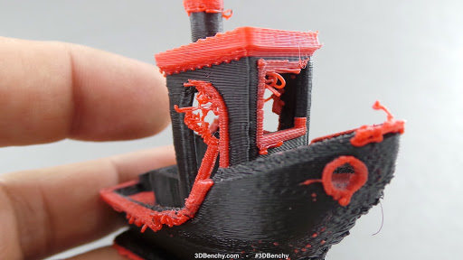
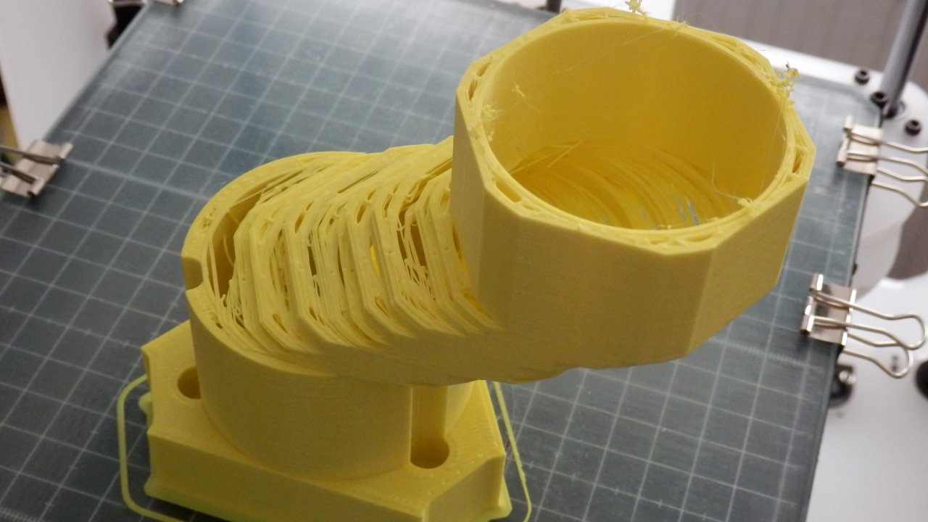
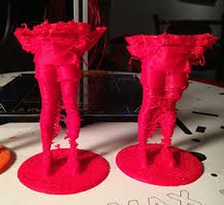
3D Print Failures

Slide 40
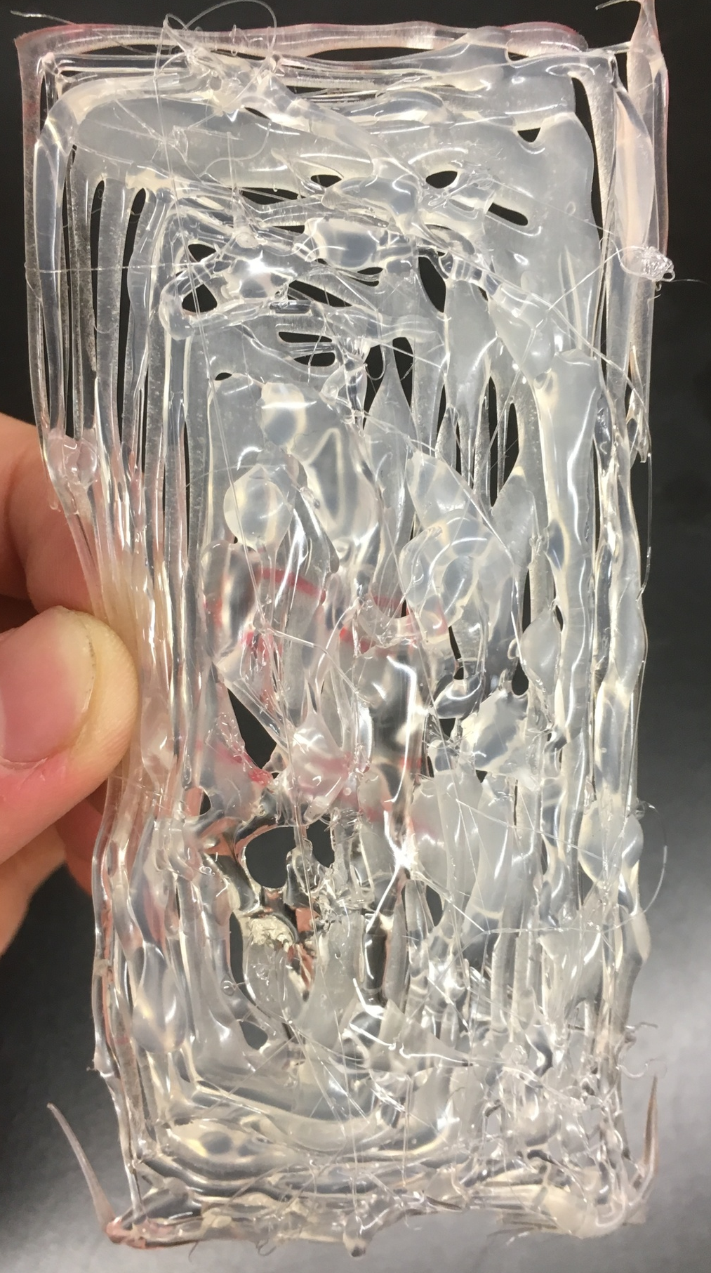
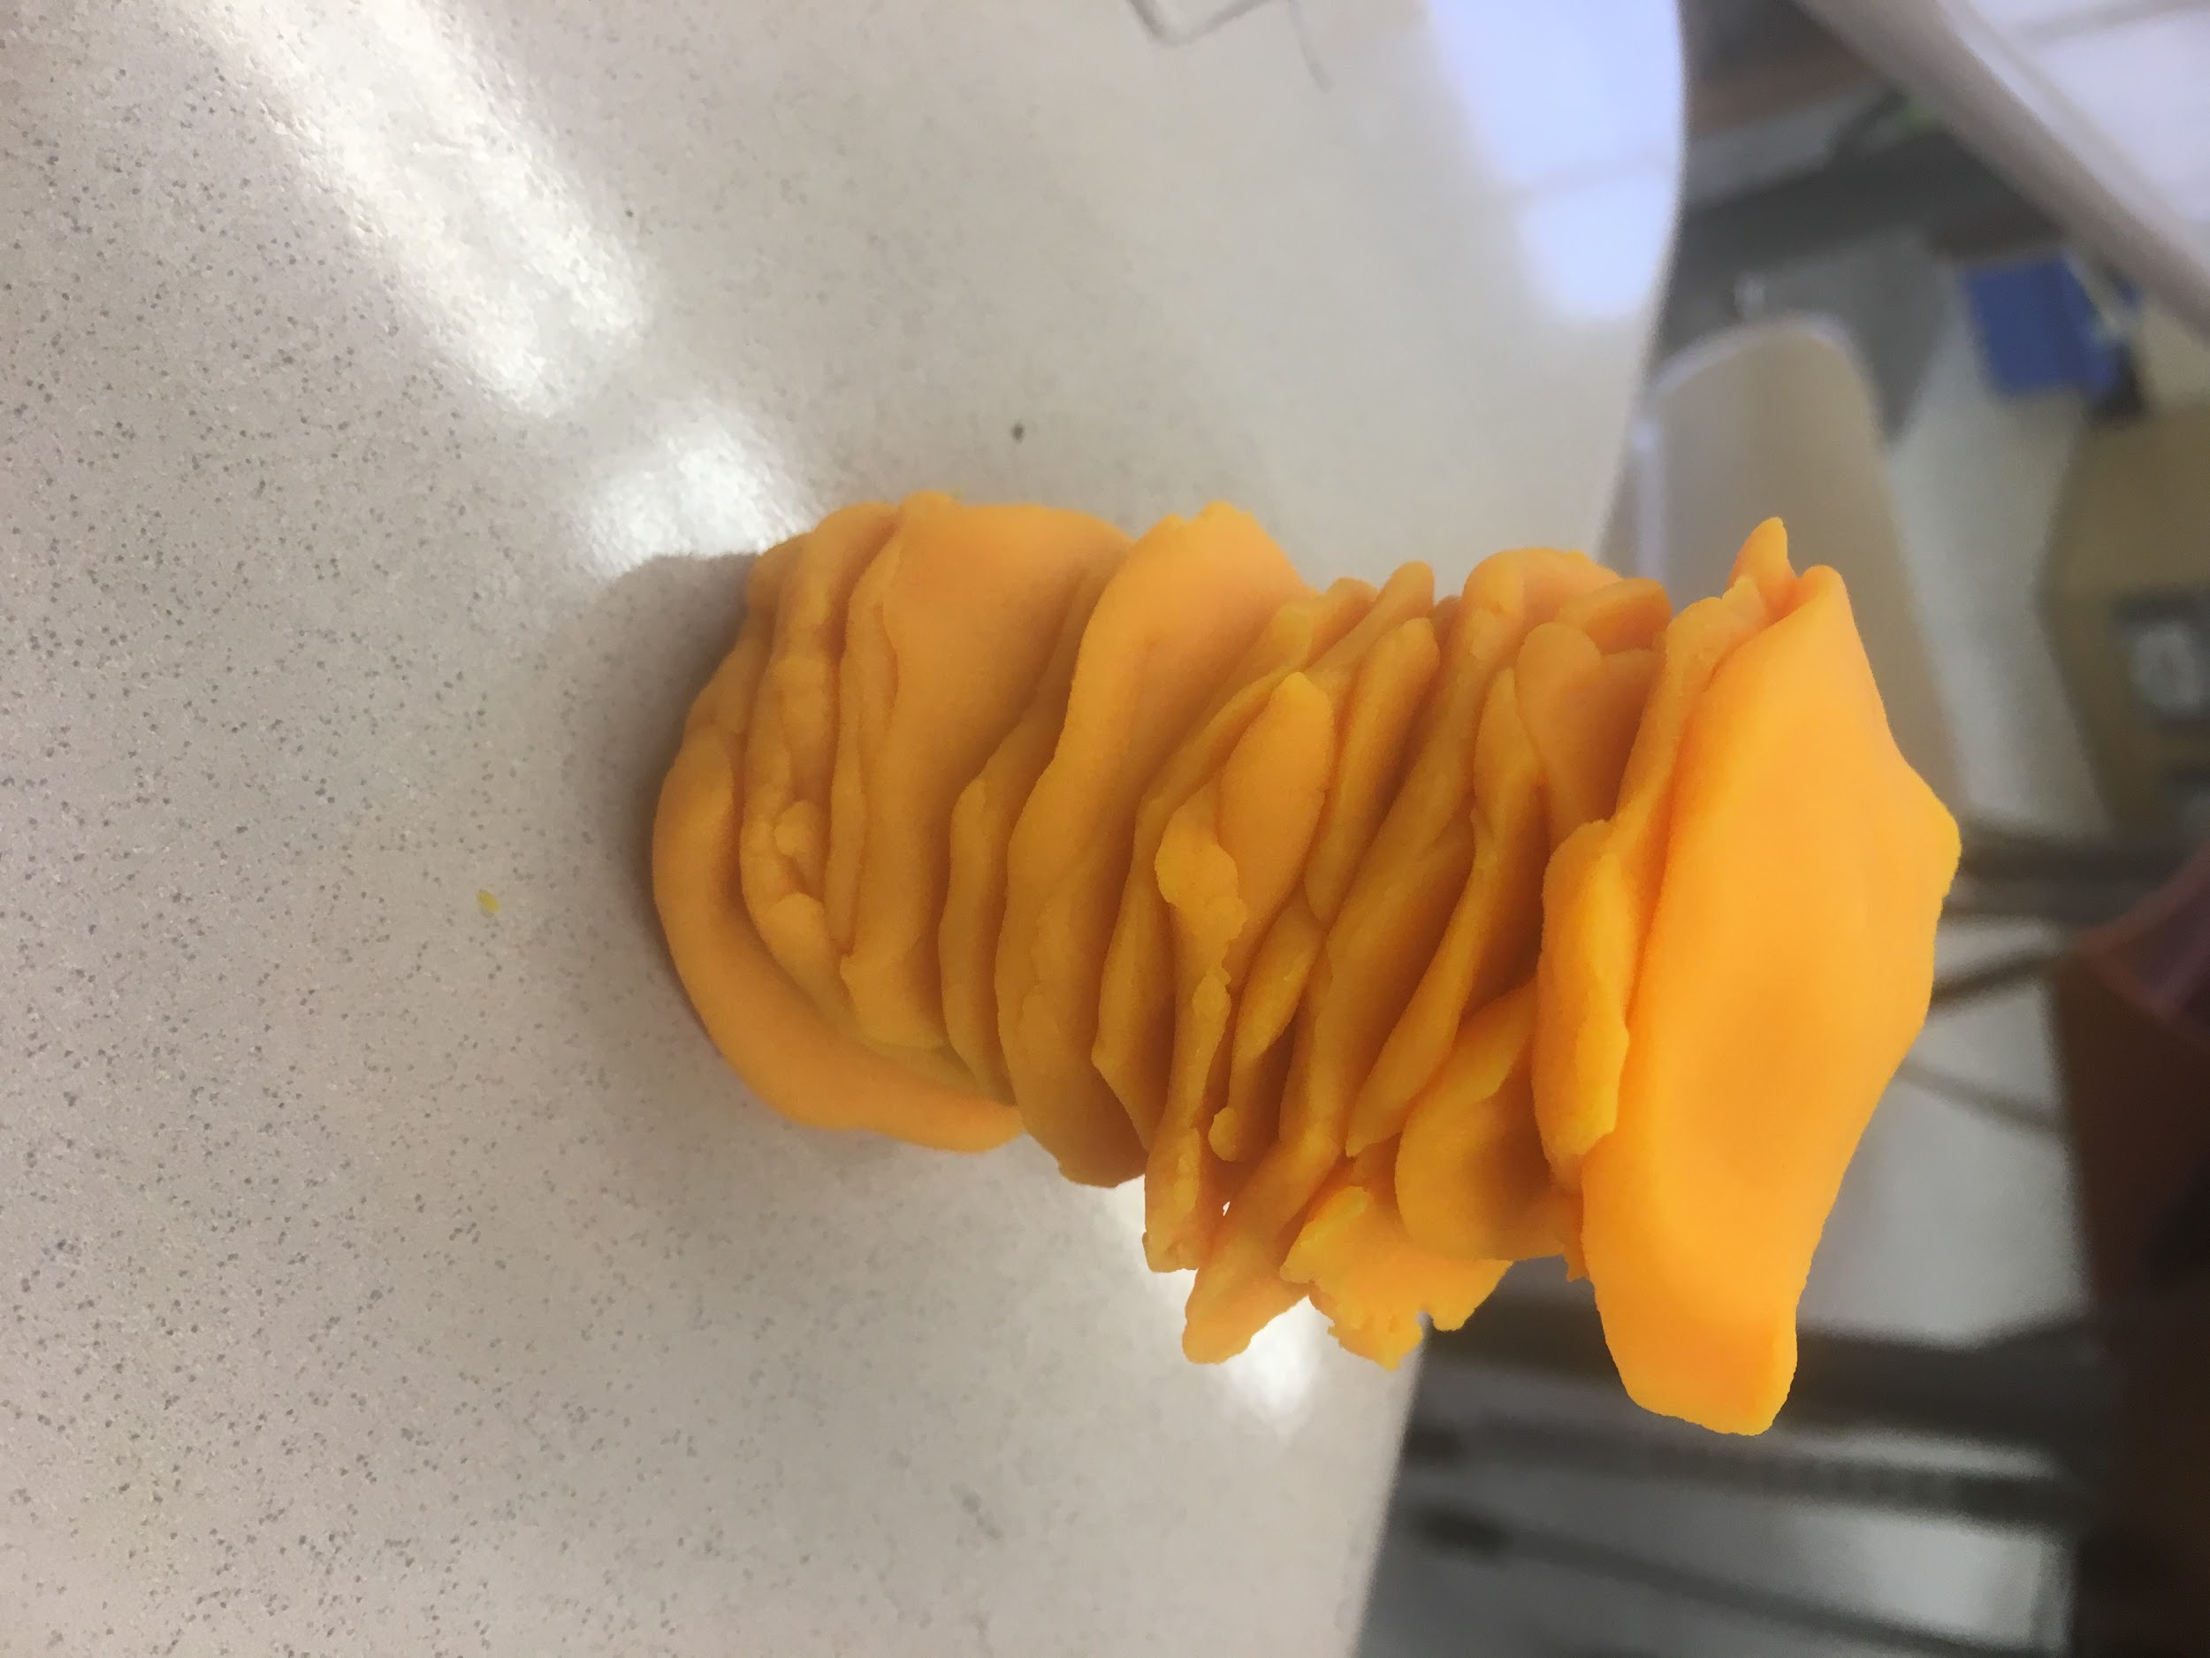
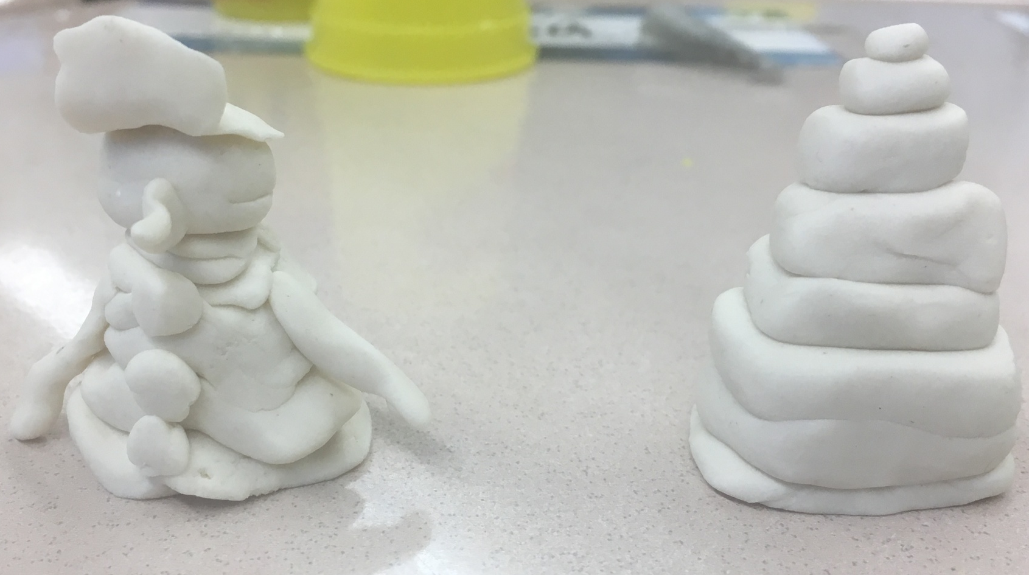
Today’s 3D activity
We have many different options for today’s 3D sculptures:
Glue
Play-Doh
Legos
Construction paper
Cardboard
Anything else that you can stack or layer

Slide 41
Let’s make a prototype and test it!
Now that you have chosen your materials, stack them into something interesting to you!
As you stack, see if your structure stays up, leans or falls. If it doesn’t look like what you wanted, how can you change it?
BRAINSTORM
IDEAS
MAKE A
PLAN
START
IDENTIFY
THE
PROBLEM
PROTOTYPE
FAILS
MAKE YOUR
PROTOTYPE
ITERATION
IMPROVE
OR
FINALIZE
TEST YOUR
PROTOTYPE

Slide 42
Let’s Improve
What worked and what didn’t while you were stacking?
What improvements will you make to your next prototype?
Ideas:
BRAINSTORM
IDEAS
MAKE A
PLAN
START
IDENTIFY
THE
PROBLEM
PROTOTYPE
FAILS
MAKE YOUR
PROTOTYPE
ITERATION
IMPROVE
OR
FINALIZE
TEST YOUR
PROTOTYPE

Slide 43
Write in our journals
?
What iterations did you make to your prototype?
Why did you make these changes?
How did you test your design?
Which parts of the Engineering Design Process did you use today?
BRAINSTORM
IDEAS
MAKE A
PLAN
?
?
START
IDENTIFY
THE
PROBLEM
PROTOTYPE
FAILS
MAKE YOUR
PROTOTYPE
ITERATION
?
IMPROVE
OR
FINALIZE
TEST YOUR
PROTOTYPE

Slide 44
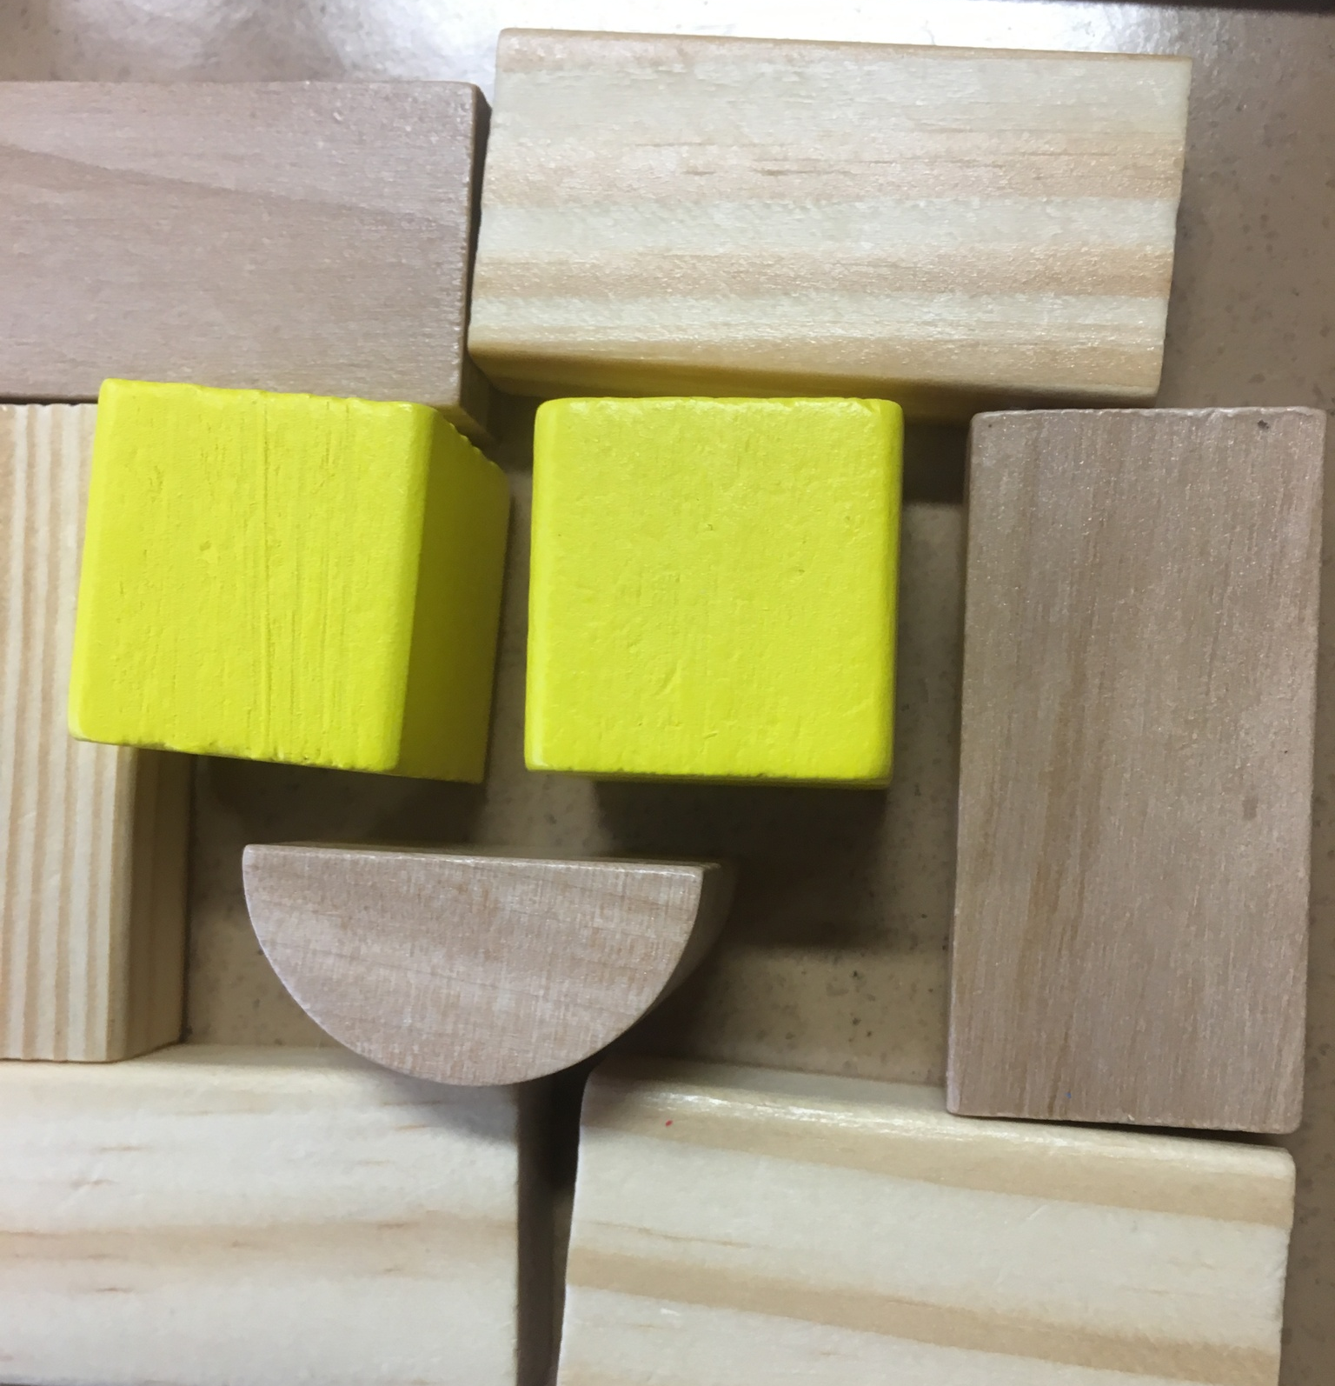
WOODEN BLOCKS
Overall Time Needed?

Slide 45
Key Vocabulary
Structure: The arrangement of parts of something
Iteration: One version of something, the process of repetition

Slide 46
Reflect
?
What we did we do last time in Maker’s Club?
What tools or materials did we use?
What did we make?
?
?

Slide 47
Materials you need:
10 wooden blocks
A ruler
Your Maker journal and a pencil

Slide 48
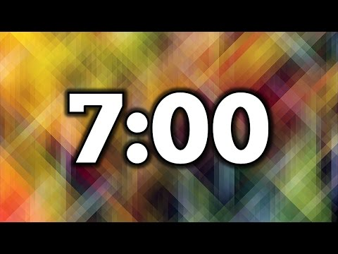
Let’s Start by Exploring
Take 7 minutes to play with the blocks
Use 10 blocks and build whatever you want!
Be ready to share what you’ve made with the group

Slide 49
Today’s Activity
Today you will design a 3D object using wooden blocks
What can you make?
BRAINSTORM
IDEAS
MAKE A
PLAN
START
IDENTIFY
THE
PROBLEM
PROTOTYPE
FAILS
MAKE YOUR
PROTOTYPE
ITERATION
IMPROVE
OR
FINALIZE
TEST YOUR
PROTOTYPE

Slide 50
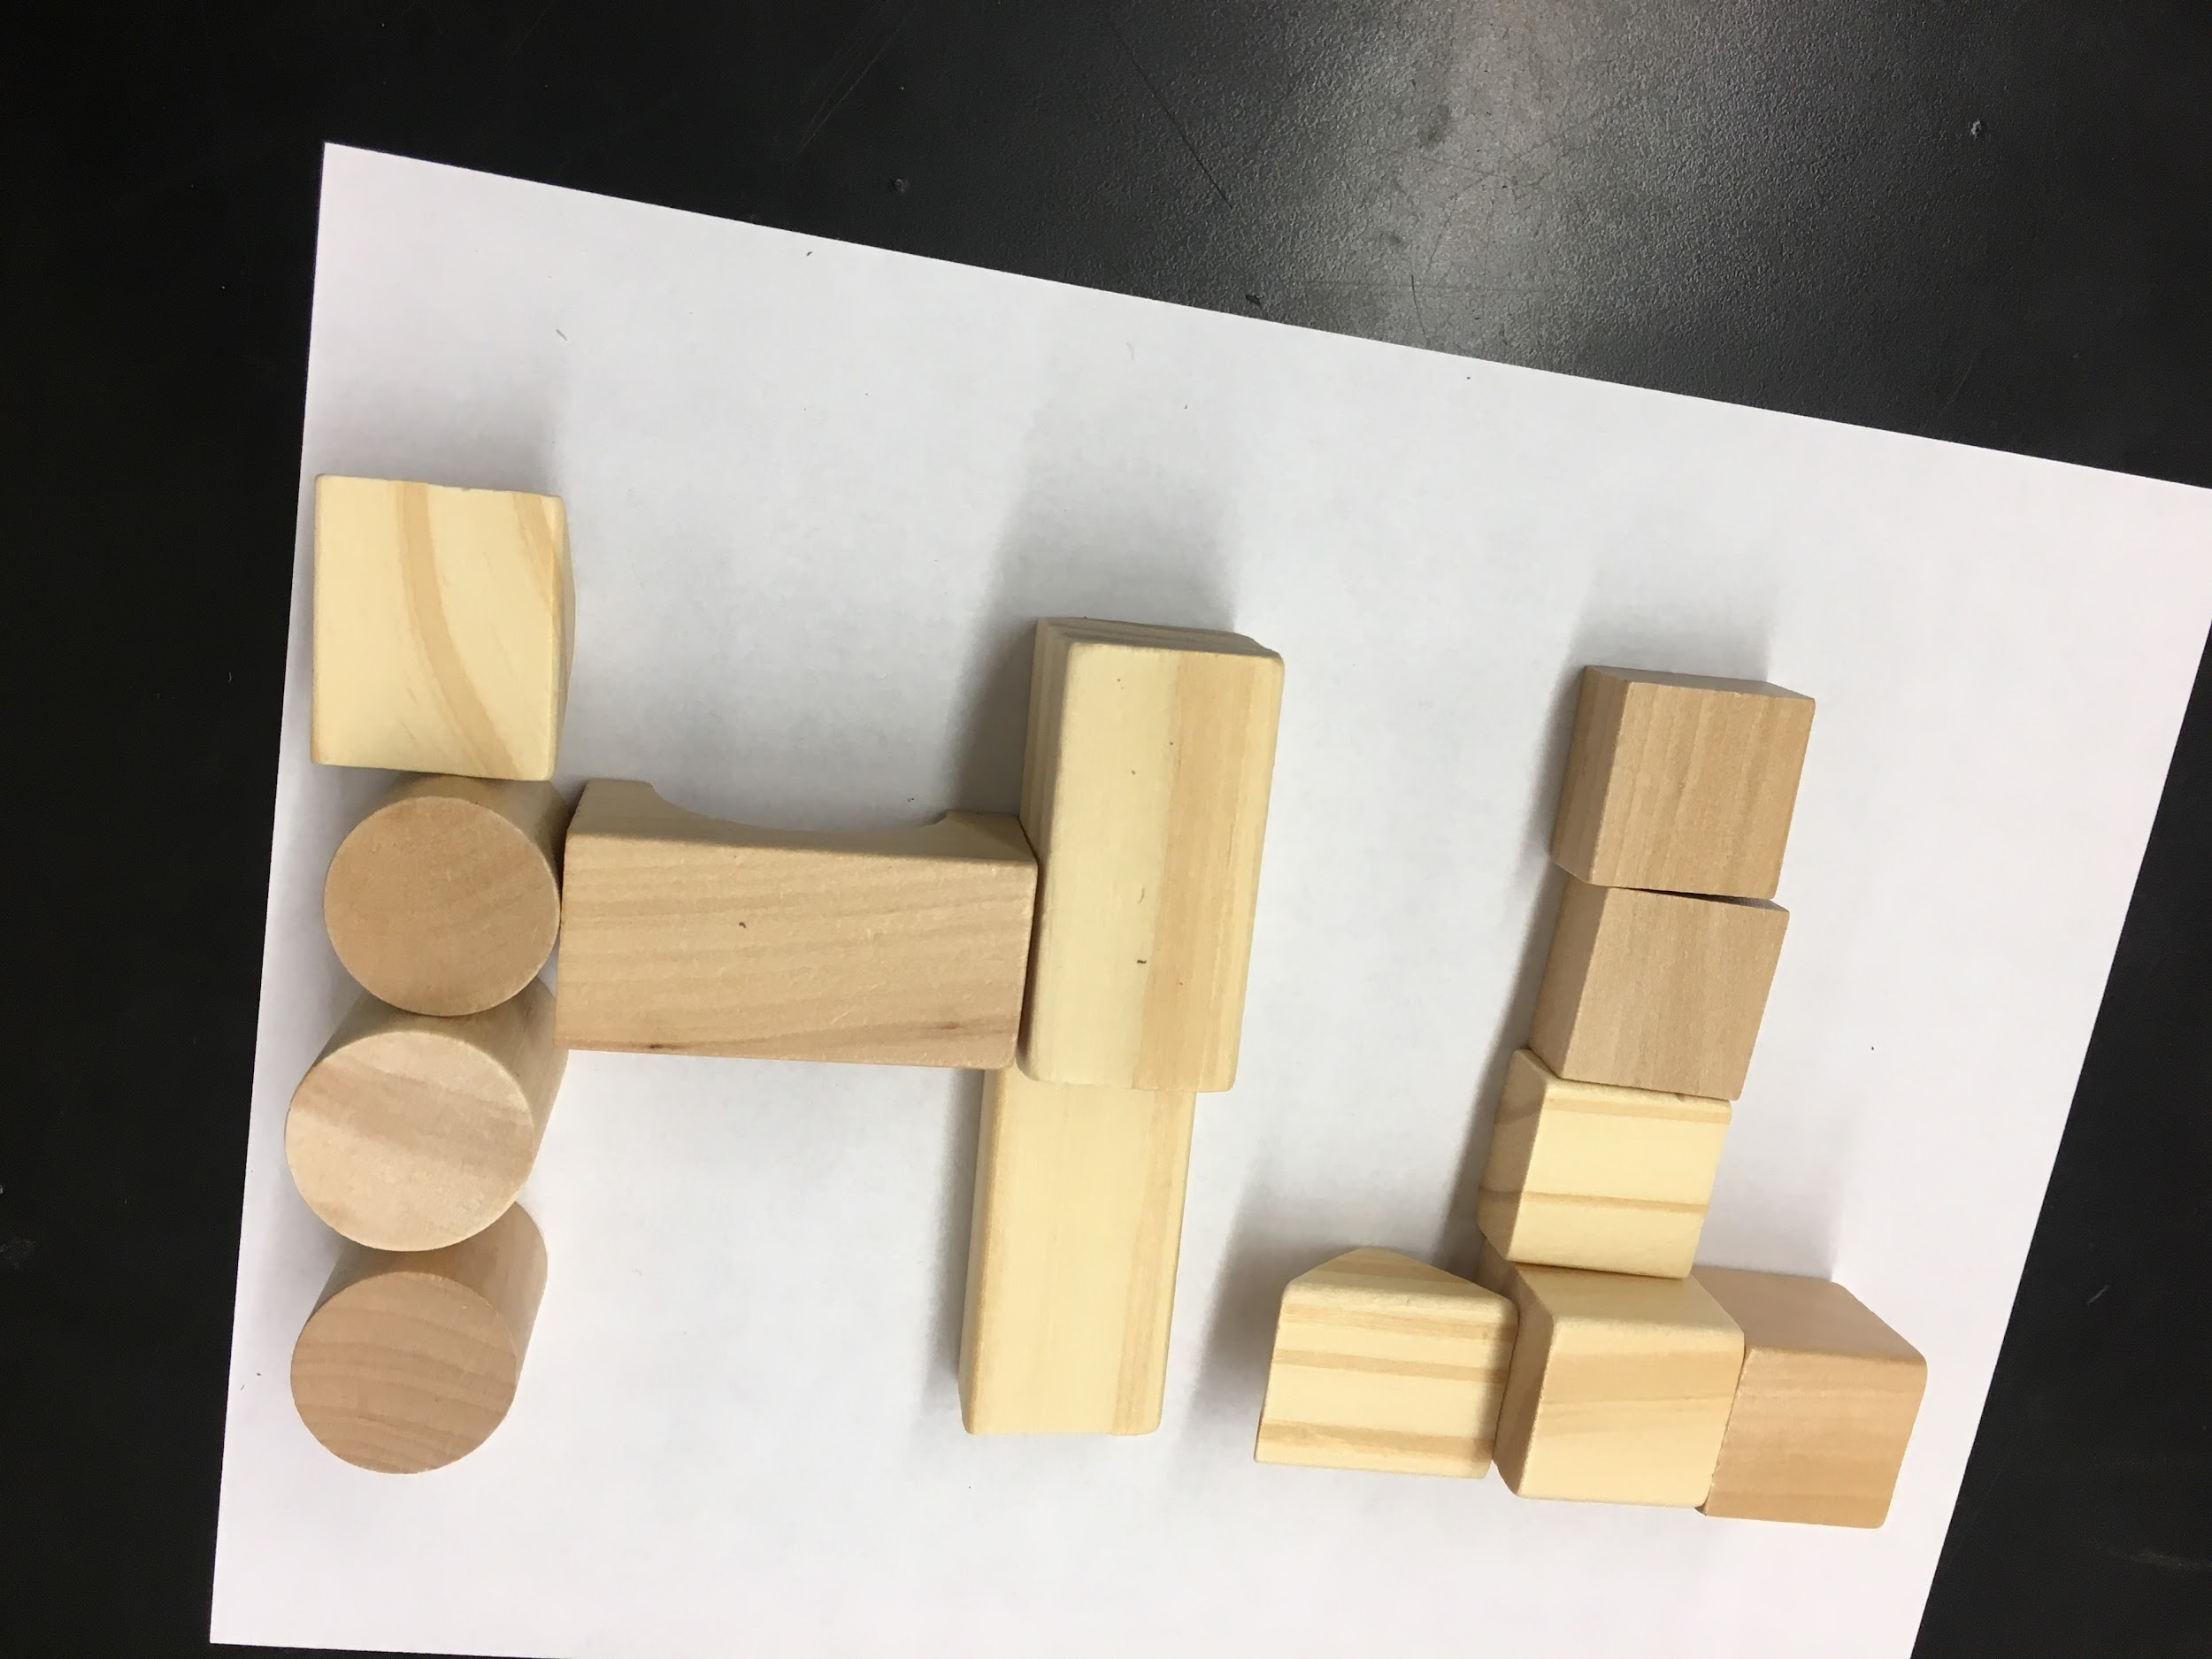
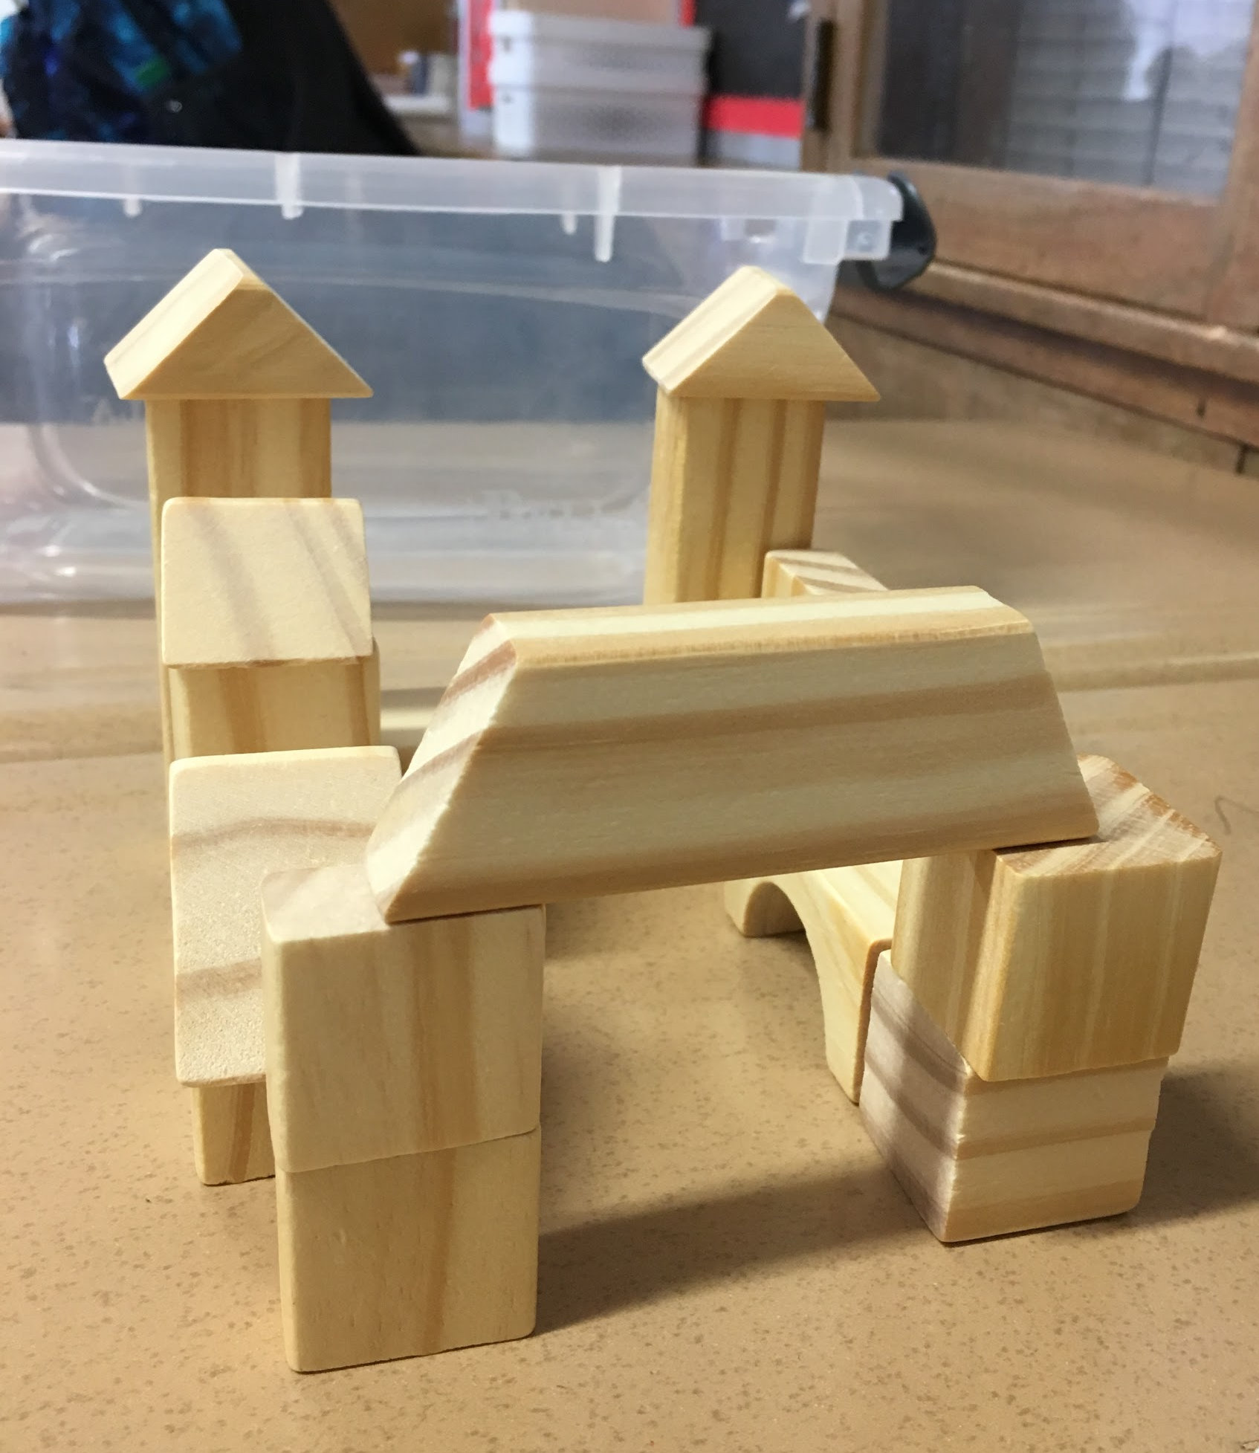
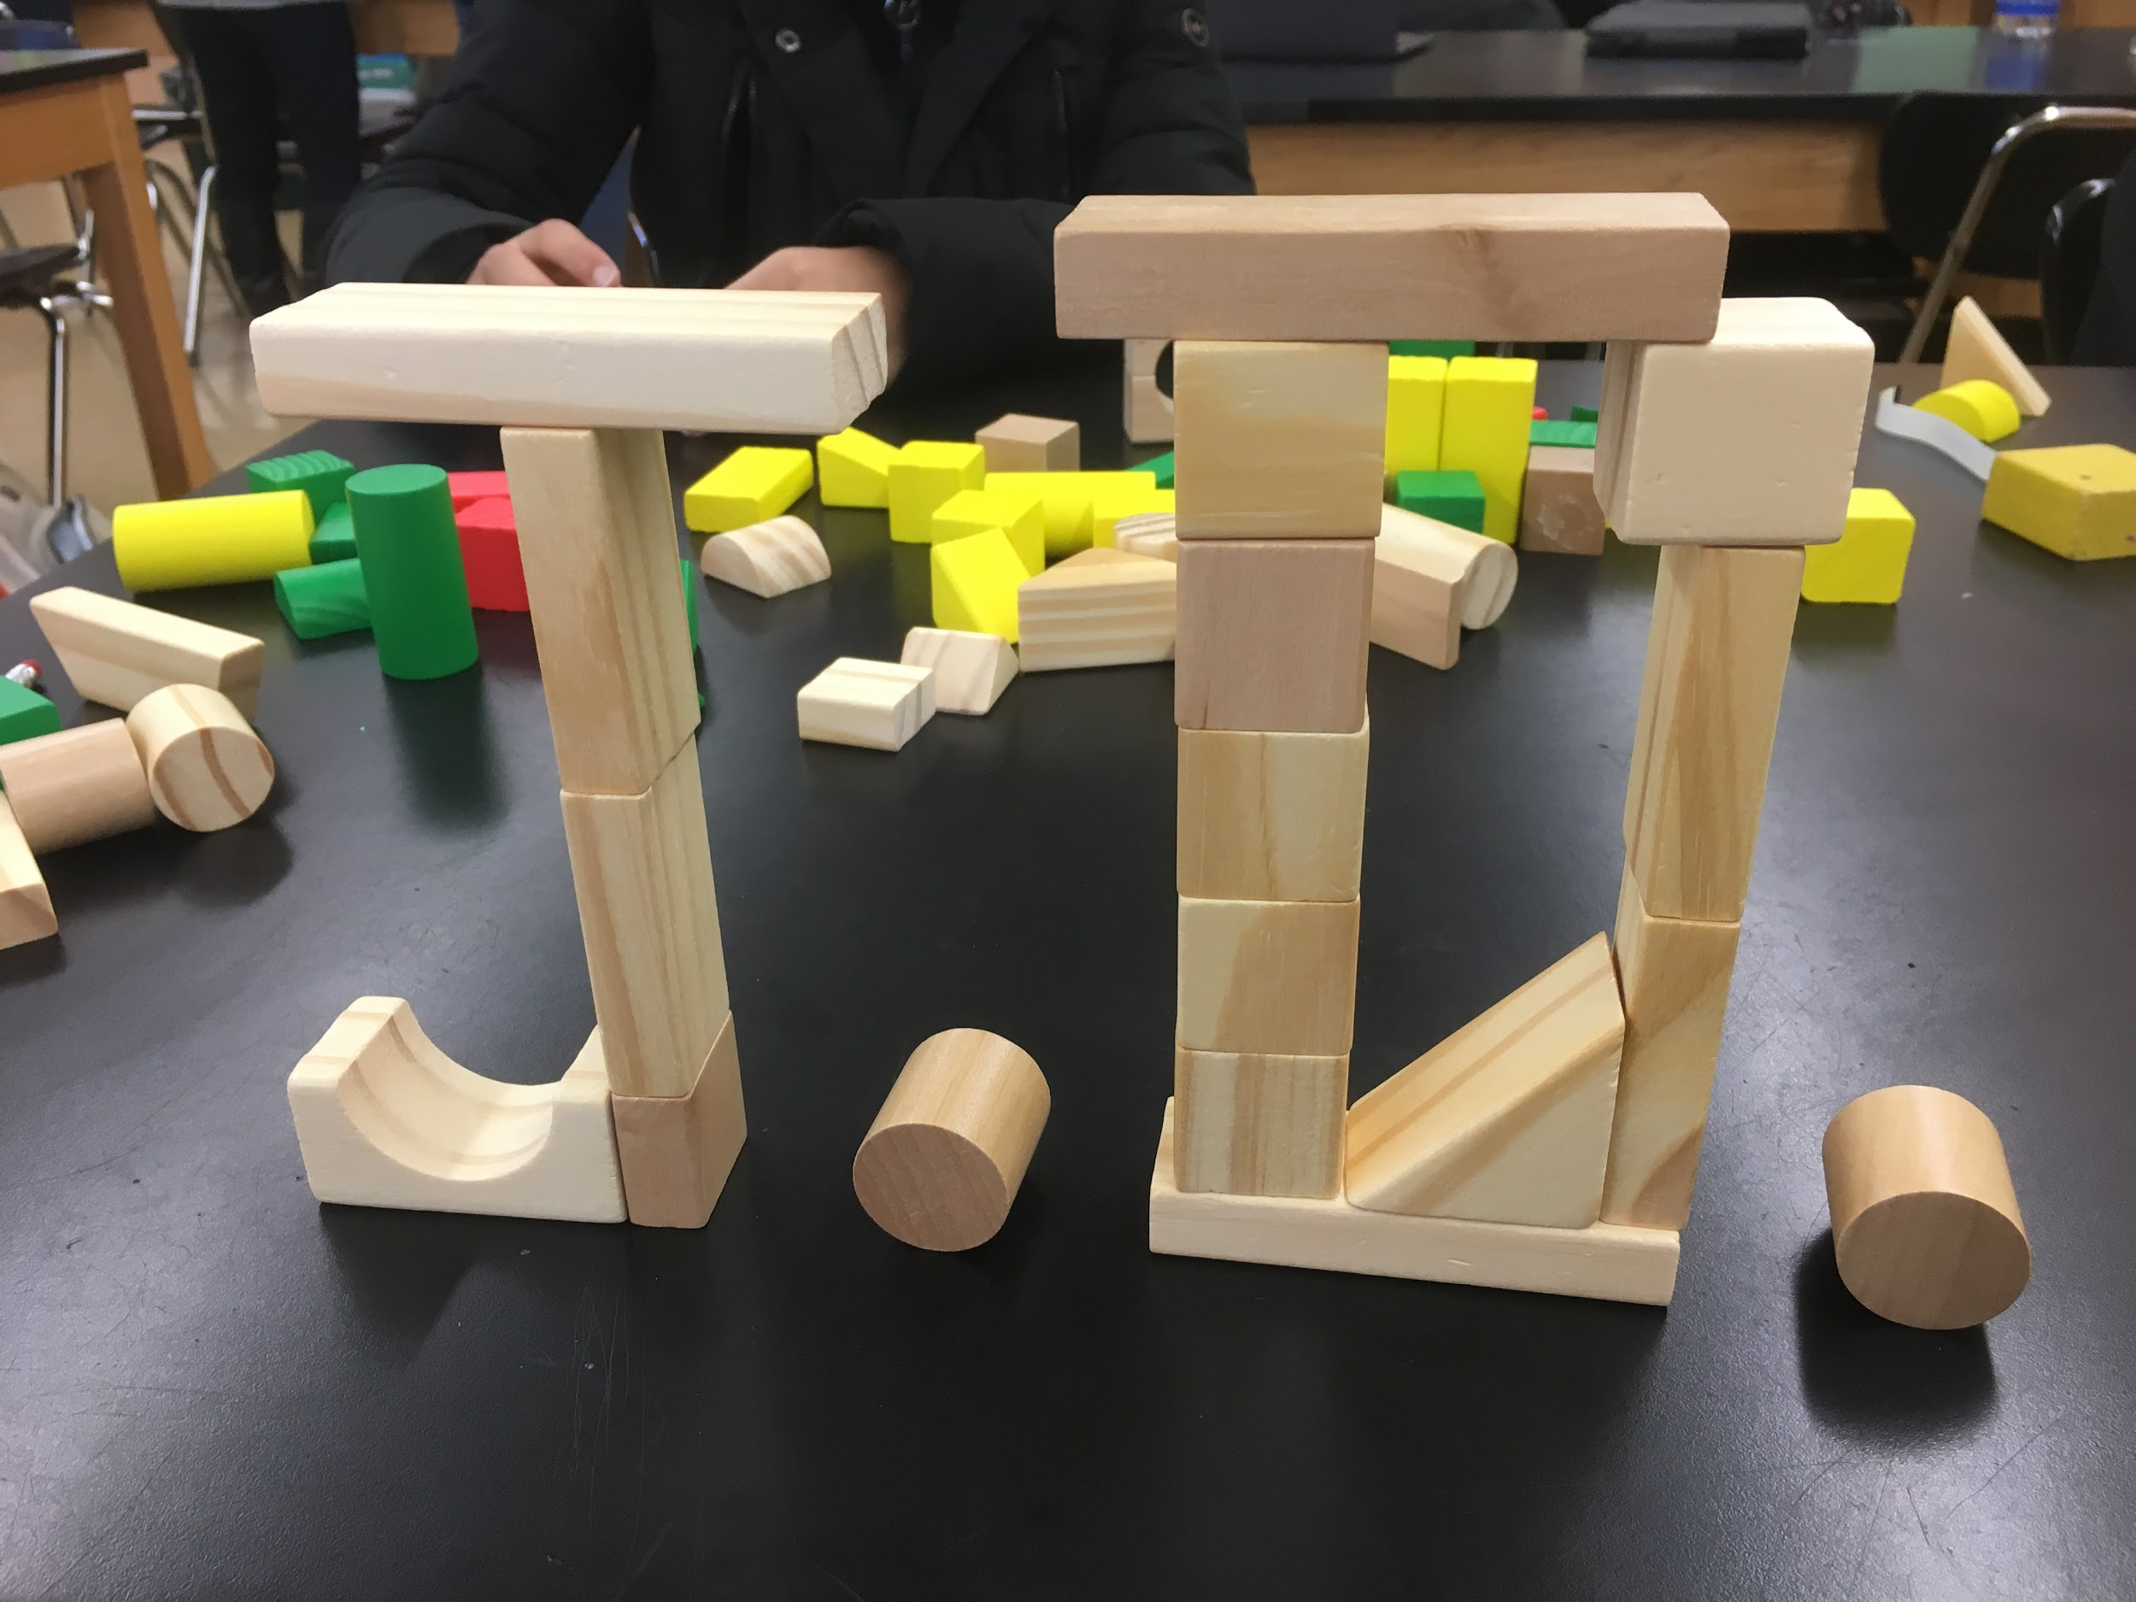
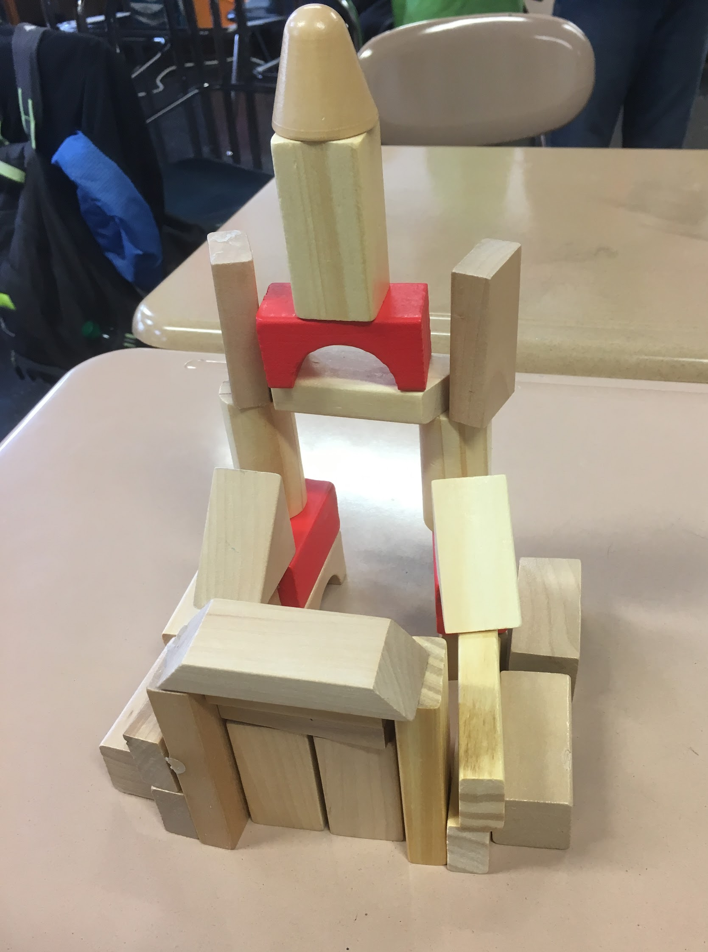
A building, your initials, a futuristic device...
Are there other materials you can use to add to your 3D design?

Slide 51
Let’s Make our Object
Design your object using the wooden blocks or other materials
Draw a diagram of your design in your journal
First draw the blocks and shape of your object
Then, measure each one of the blocks and write down the measurements in your journal. Be sure to include the height, width, and depth of each block!
BRAINSTORM
IDEAS
MAKE A
PLAN
START
IDENTIFY
THE
PROBLEM
PROTOTYPE
FAILS
MAKE YOUR
PROTOTYPE
ITERATION
IMPROVE
OR
FINALIZE
TEST YOUR
PROTOTYPE

Slide 52
Review the Engineering Design Process
?
Are you happy with your design?
Did you need to make changes or iterations?
Would you like to make any improvements?
BRAINSTORM
IDEAS
MAKE A
PLAN
?
START
IDENTIFY
THE
PROBLEM
PROTOTYPE
FAILS
MAKE YOUR
PROTOTYPE
?
ITERATION
IMPROVE
OR
FINALIZE
TEST YOUR
PROTOTYPE

Slide 53
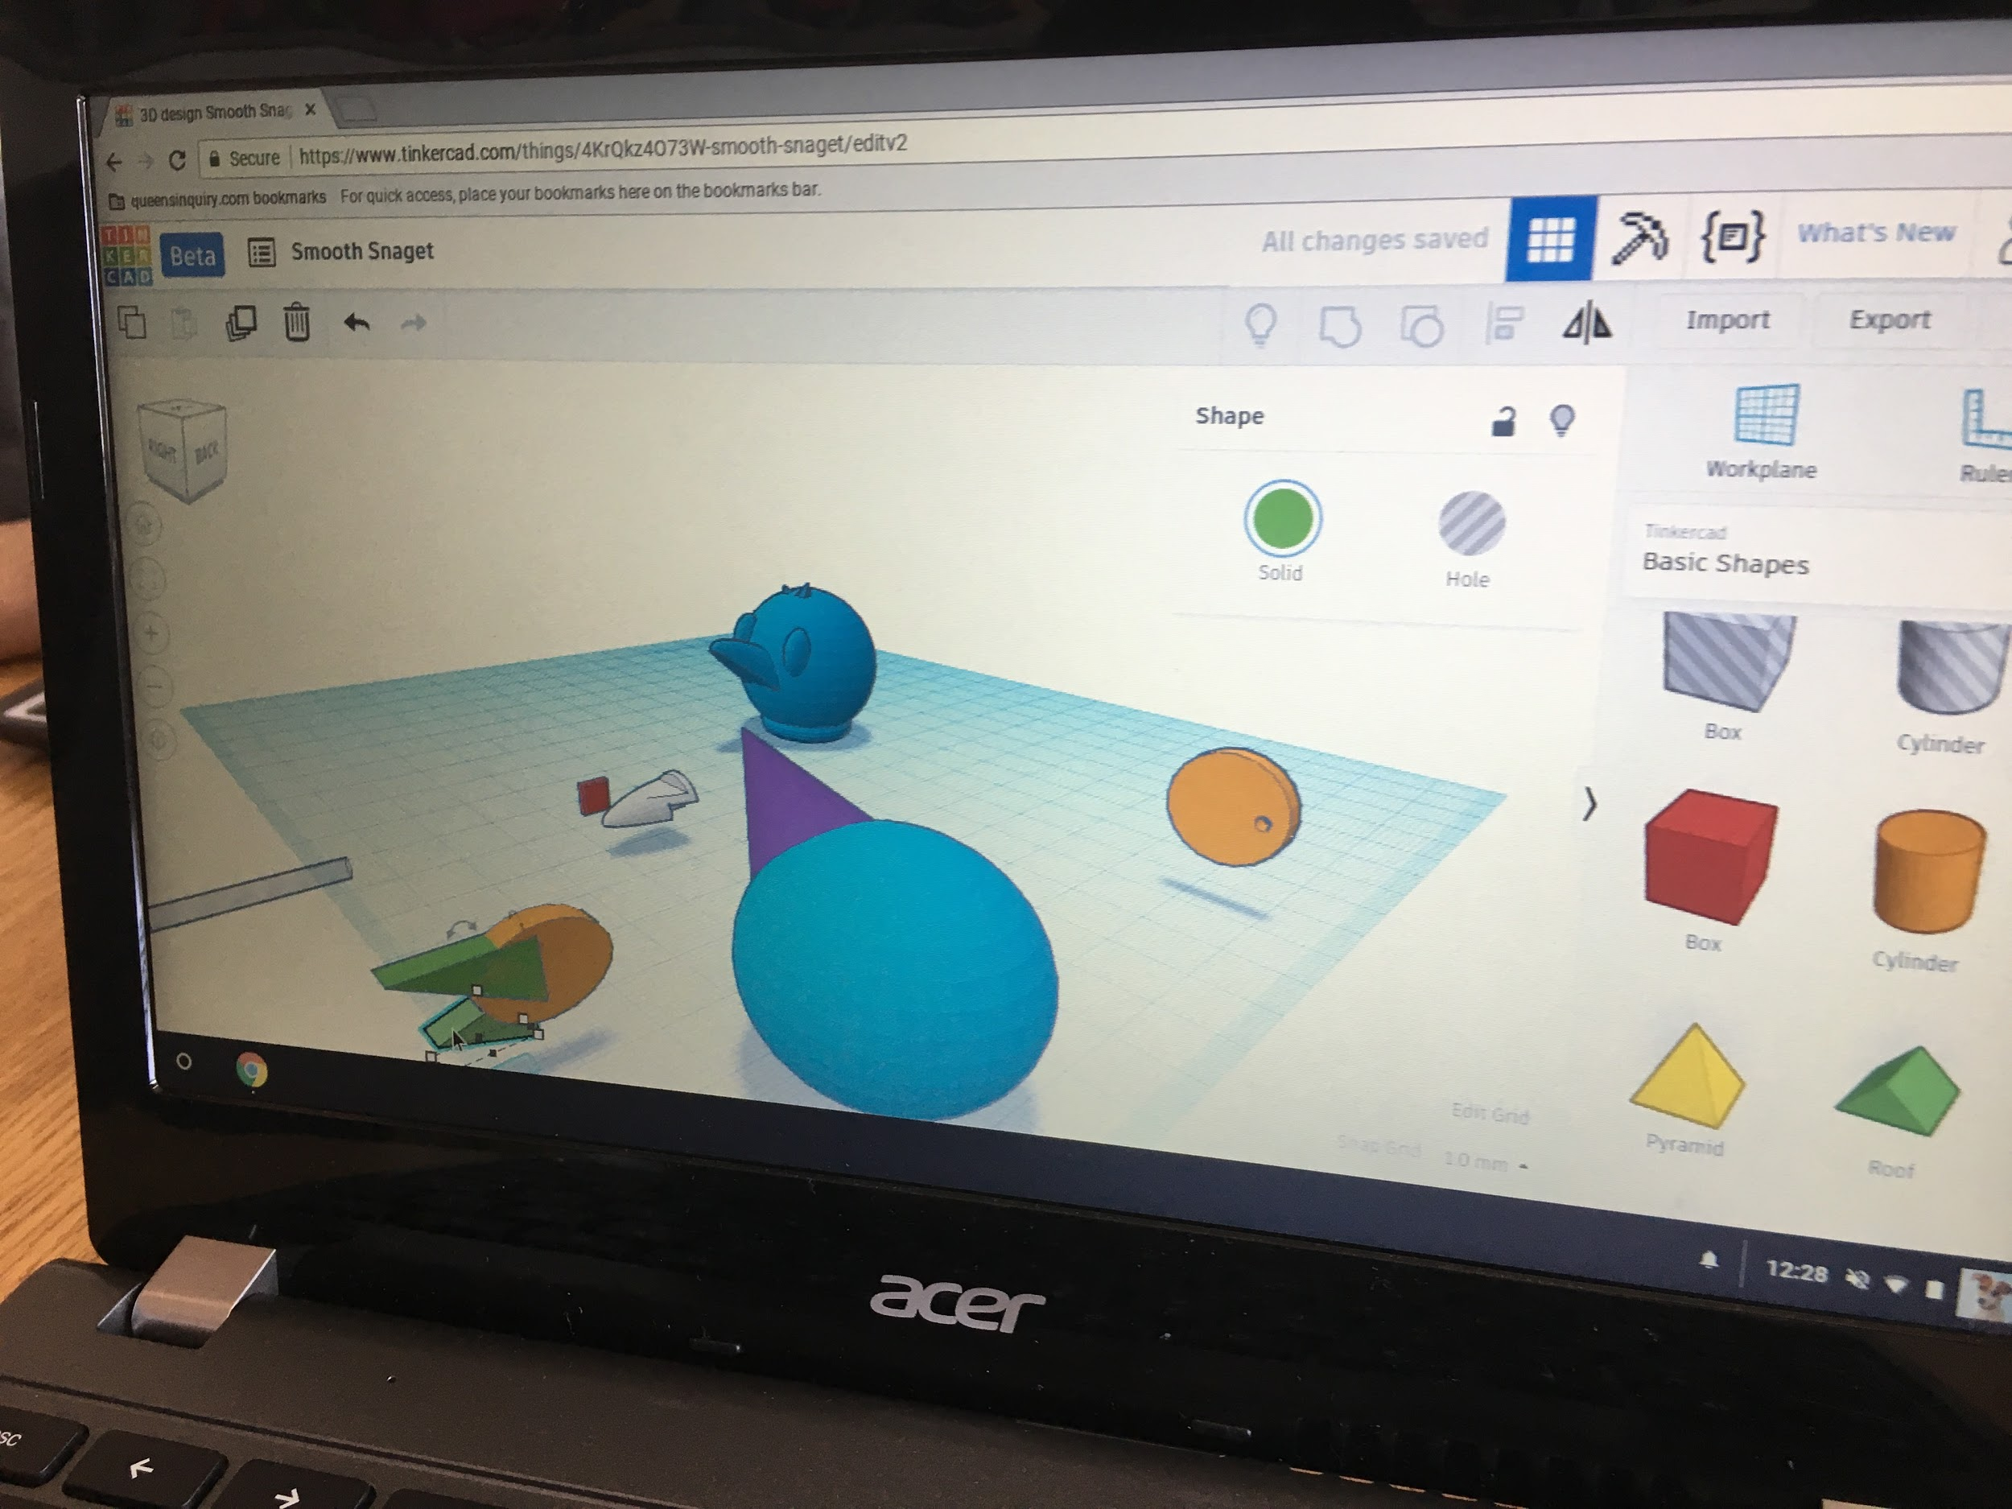
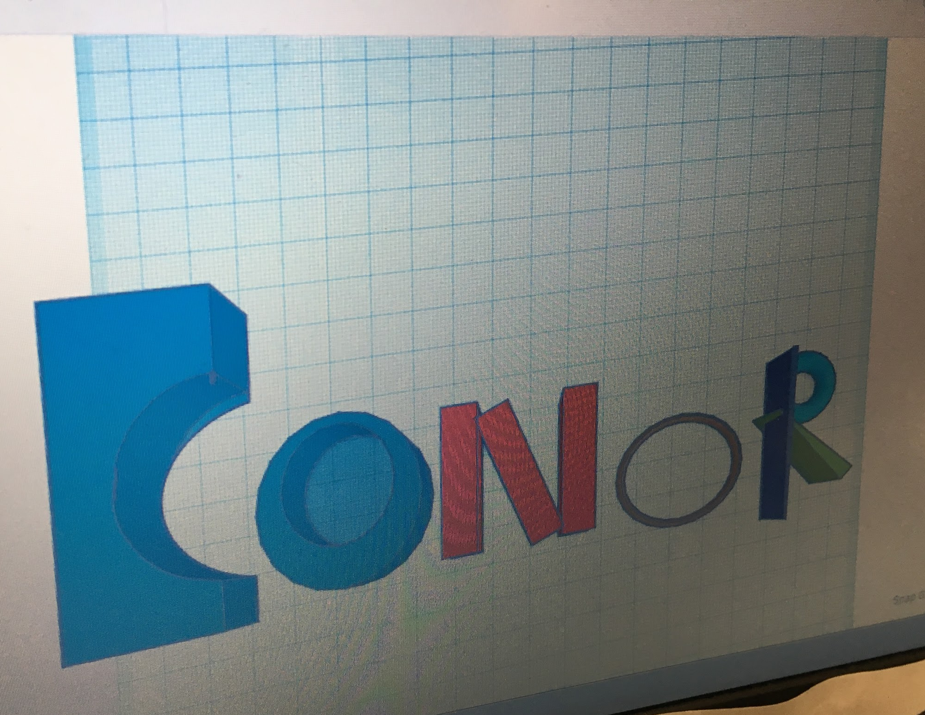
TINKERCAD
Overall Time Needed?

Slide 54
Key Vocabulary
Tinkercad: An online 3D modeling program
3D modeling: The process of creating a digital representation of a 3D object
Workplane: A virtual 2D surface

Slide 55
Reflect
?
What we did we do last time in Maker’s Club?
What tools or materials did we use?
What did we make?
?
?

Slide 56
Introduction to Tinkercad
Learn about Tinkercad 3D modeling software
Revisit prototyping and learn about the iteration process
Understand how to transition from physical to digital design
Create a 3D model of our wooden block prototypes

Slide 57
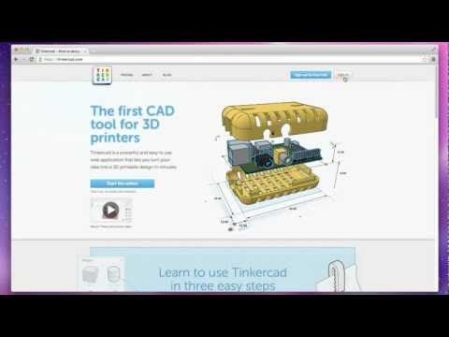
Tinkercad Basics - option 1 (shapes and movement)

Slide 58
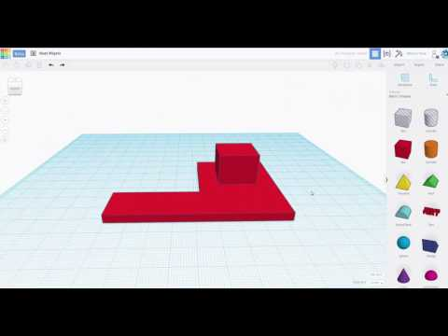
Tinkercad Basics - Option 2

Slide 59
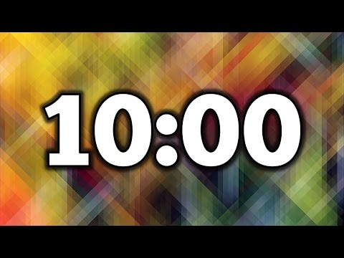
Explore
Use the next 10 minutes to explore TinkerCAD on your own
** Be ready to share your designs with the club when the timer is up! **

Slide 60
Reflect on your design
What did you design?
What iterations did you make to your design?
Why did you make these changes?
How did you test your design?
Did you get help from others?
BRAINSTORM
IDEAS
MAKE A
PLAN
START
IDENTIFY
THE
PROBLEM
PROTOTYPE
FAILS
MAKE YOUR
PROTOTYPE
ITERATION
IMPROVE
OR
FINALIZE
TEST YOUR
PROTOTYPE

Slide 61
Explore
Use the next 10 minutes to make your design more complex
Try making holes and grouping shapes
** Be ready to share your designs with the club when the timer is up! **

Slide 62
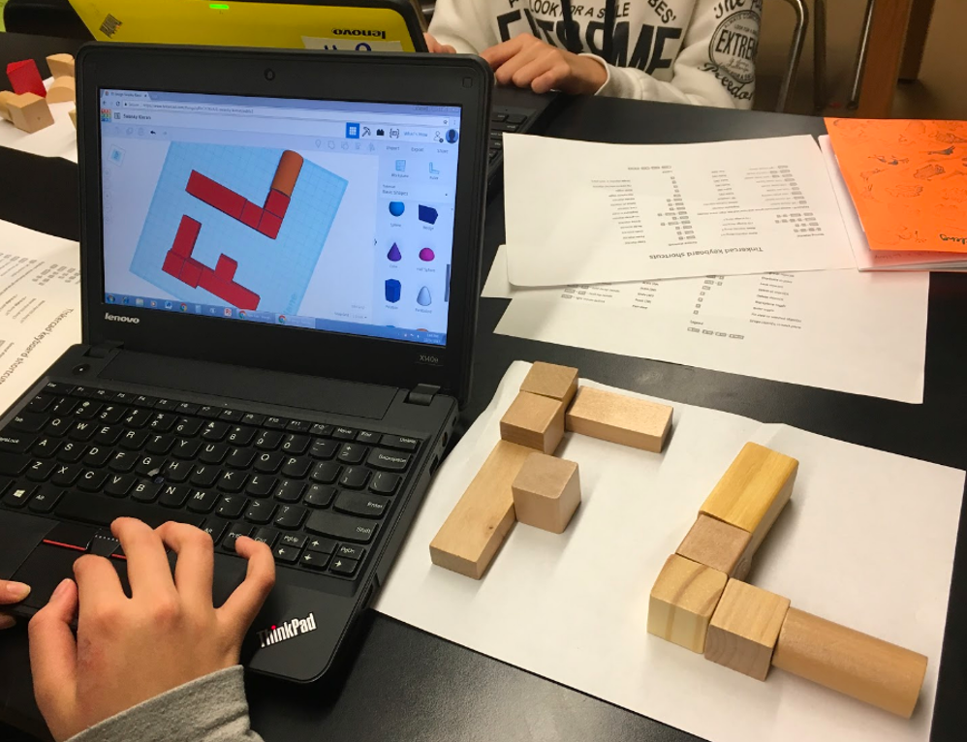
Transfer block creation into Tinkercad
Revisit your sketched object in your journal. You can use this as your plan.
What shapes do you need in Tinkercad?
How do we make them the correct size?
?
?

Slide 63
Design!
Make your prototype design of your block creation in tinkercad.
** Be ready to share your designs with the club when the timer is up! **
BRAINSTORM
IDEAS
MAKE A
PLAN
START
IDENTIFY
THE
PROBLEM
PROTOTYPE
FAILS
MAKE YOUR
PROTOTYPE
ITERATION
IMPROVE
OR
FINALIZE
TEST YOUR
PROTOTYPE

Slide 65
Share your designs with the club!
?
What worked well during this activity?
What didn’t work so well?
How did you fix what didn’t work?
What would you like to build next time?
?
?
?

Slide 66
Reflect in your journal
After looking at the engineering design process, what steps did you use?
What actions did you take?
BRAINSTORM
IDEAS
MAKE A
PLAN
START
IDENTIFY
THE
PROBLEM
PROTOTYPE
FAILS
MAKE YOUR
PROTOTYPE
ITERATION
IMPROVE
OR
FINALIZE
TEST YOUR
PROTOTYPE

Slide 67
We will use these materials next time:
Copper tape
Coin Cell batteries
LED
Index card or cardstock
binder clips
scissors
tape
Your journal

Slide 68
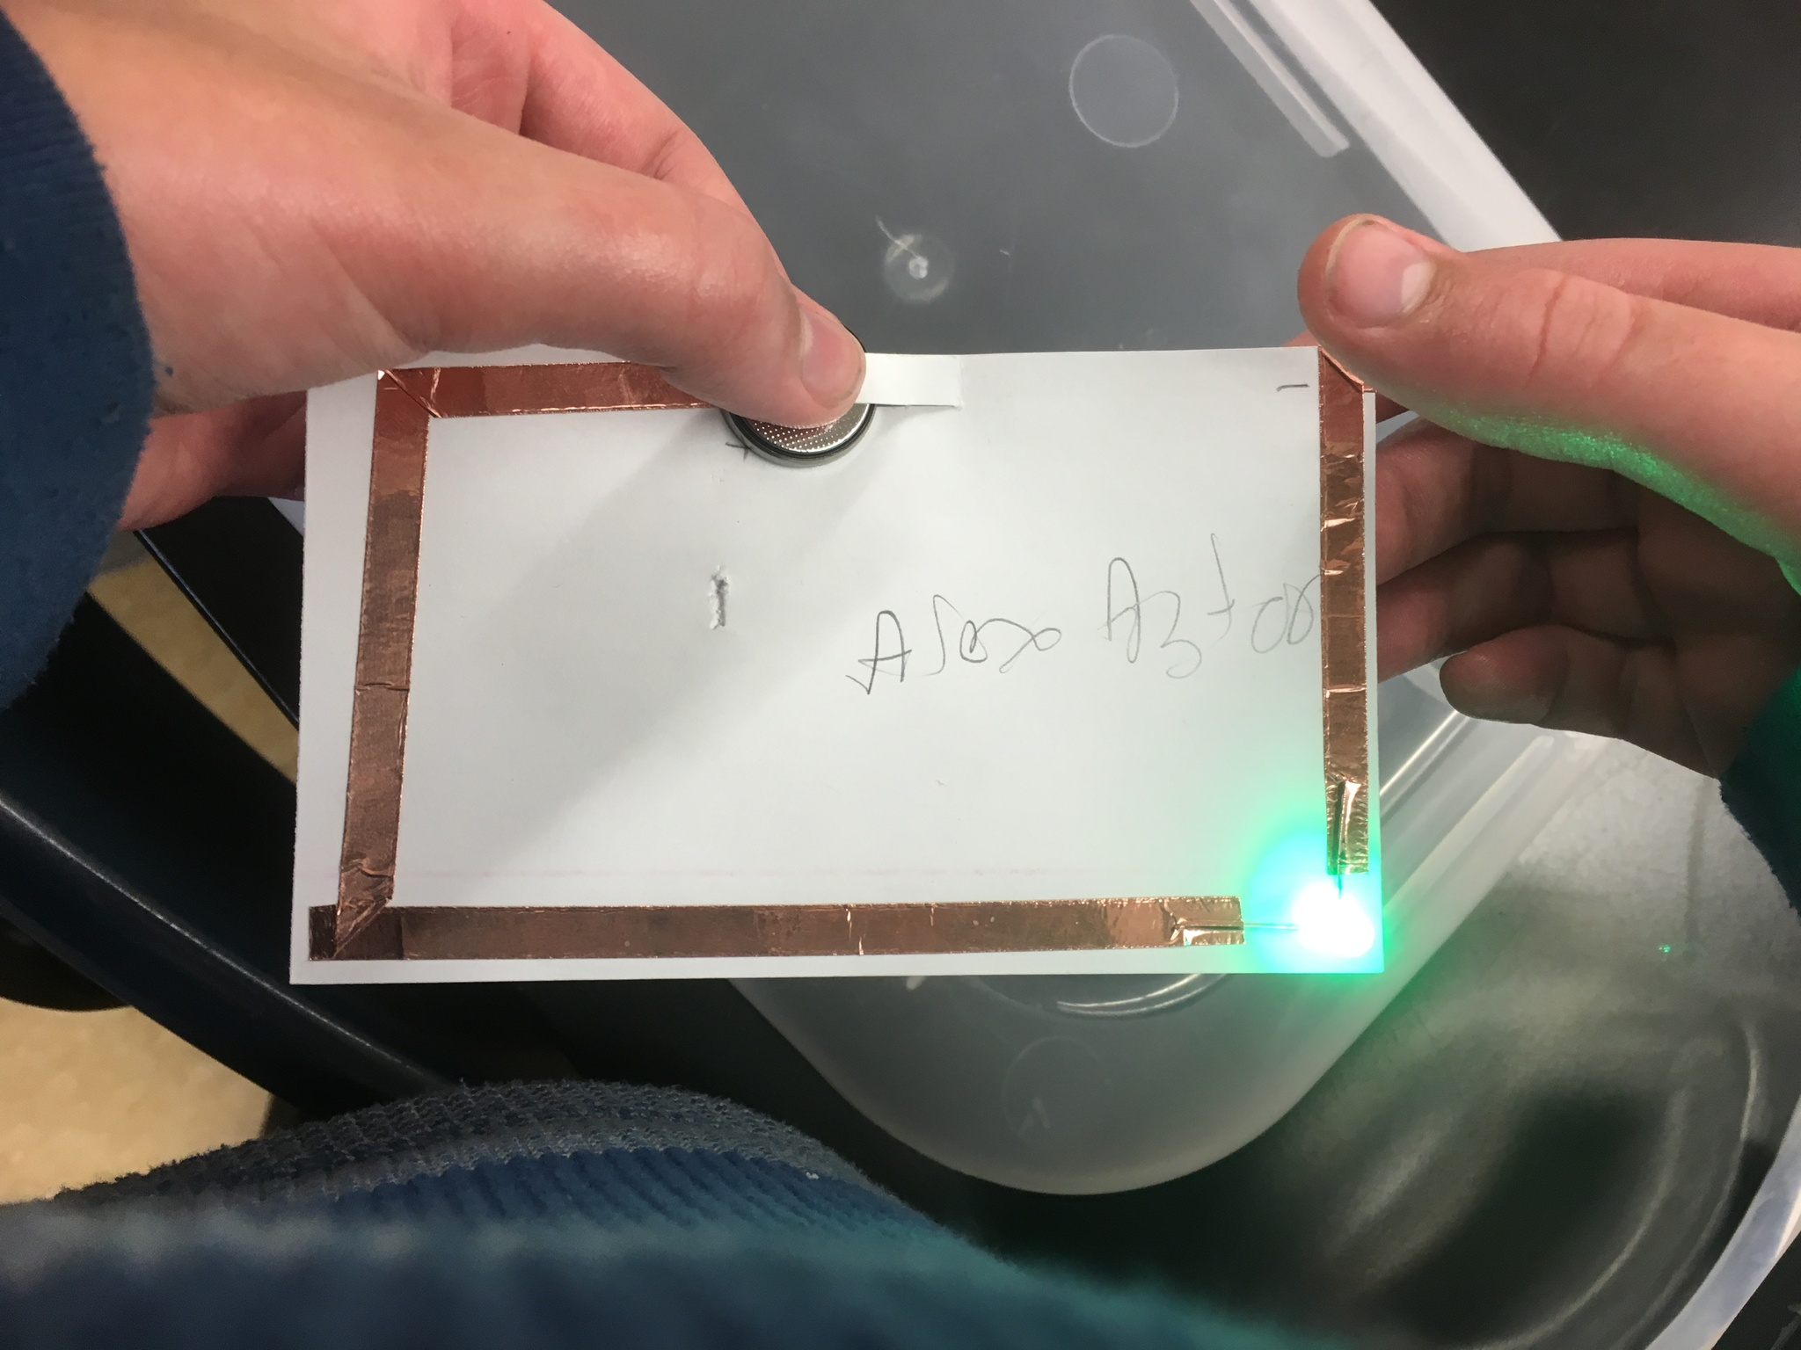
Paper Circuits
1.5 hours

Slide 69
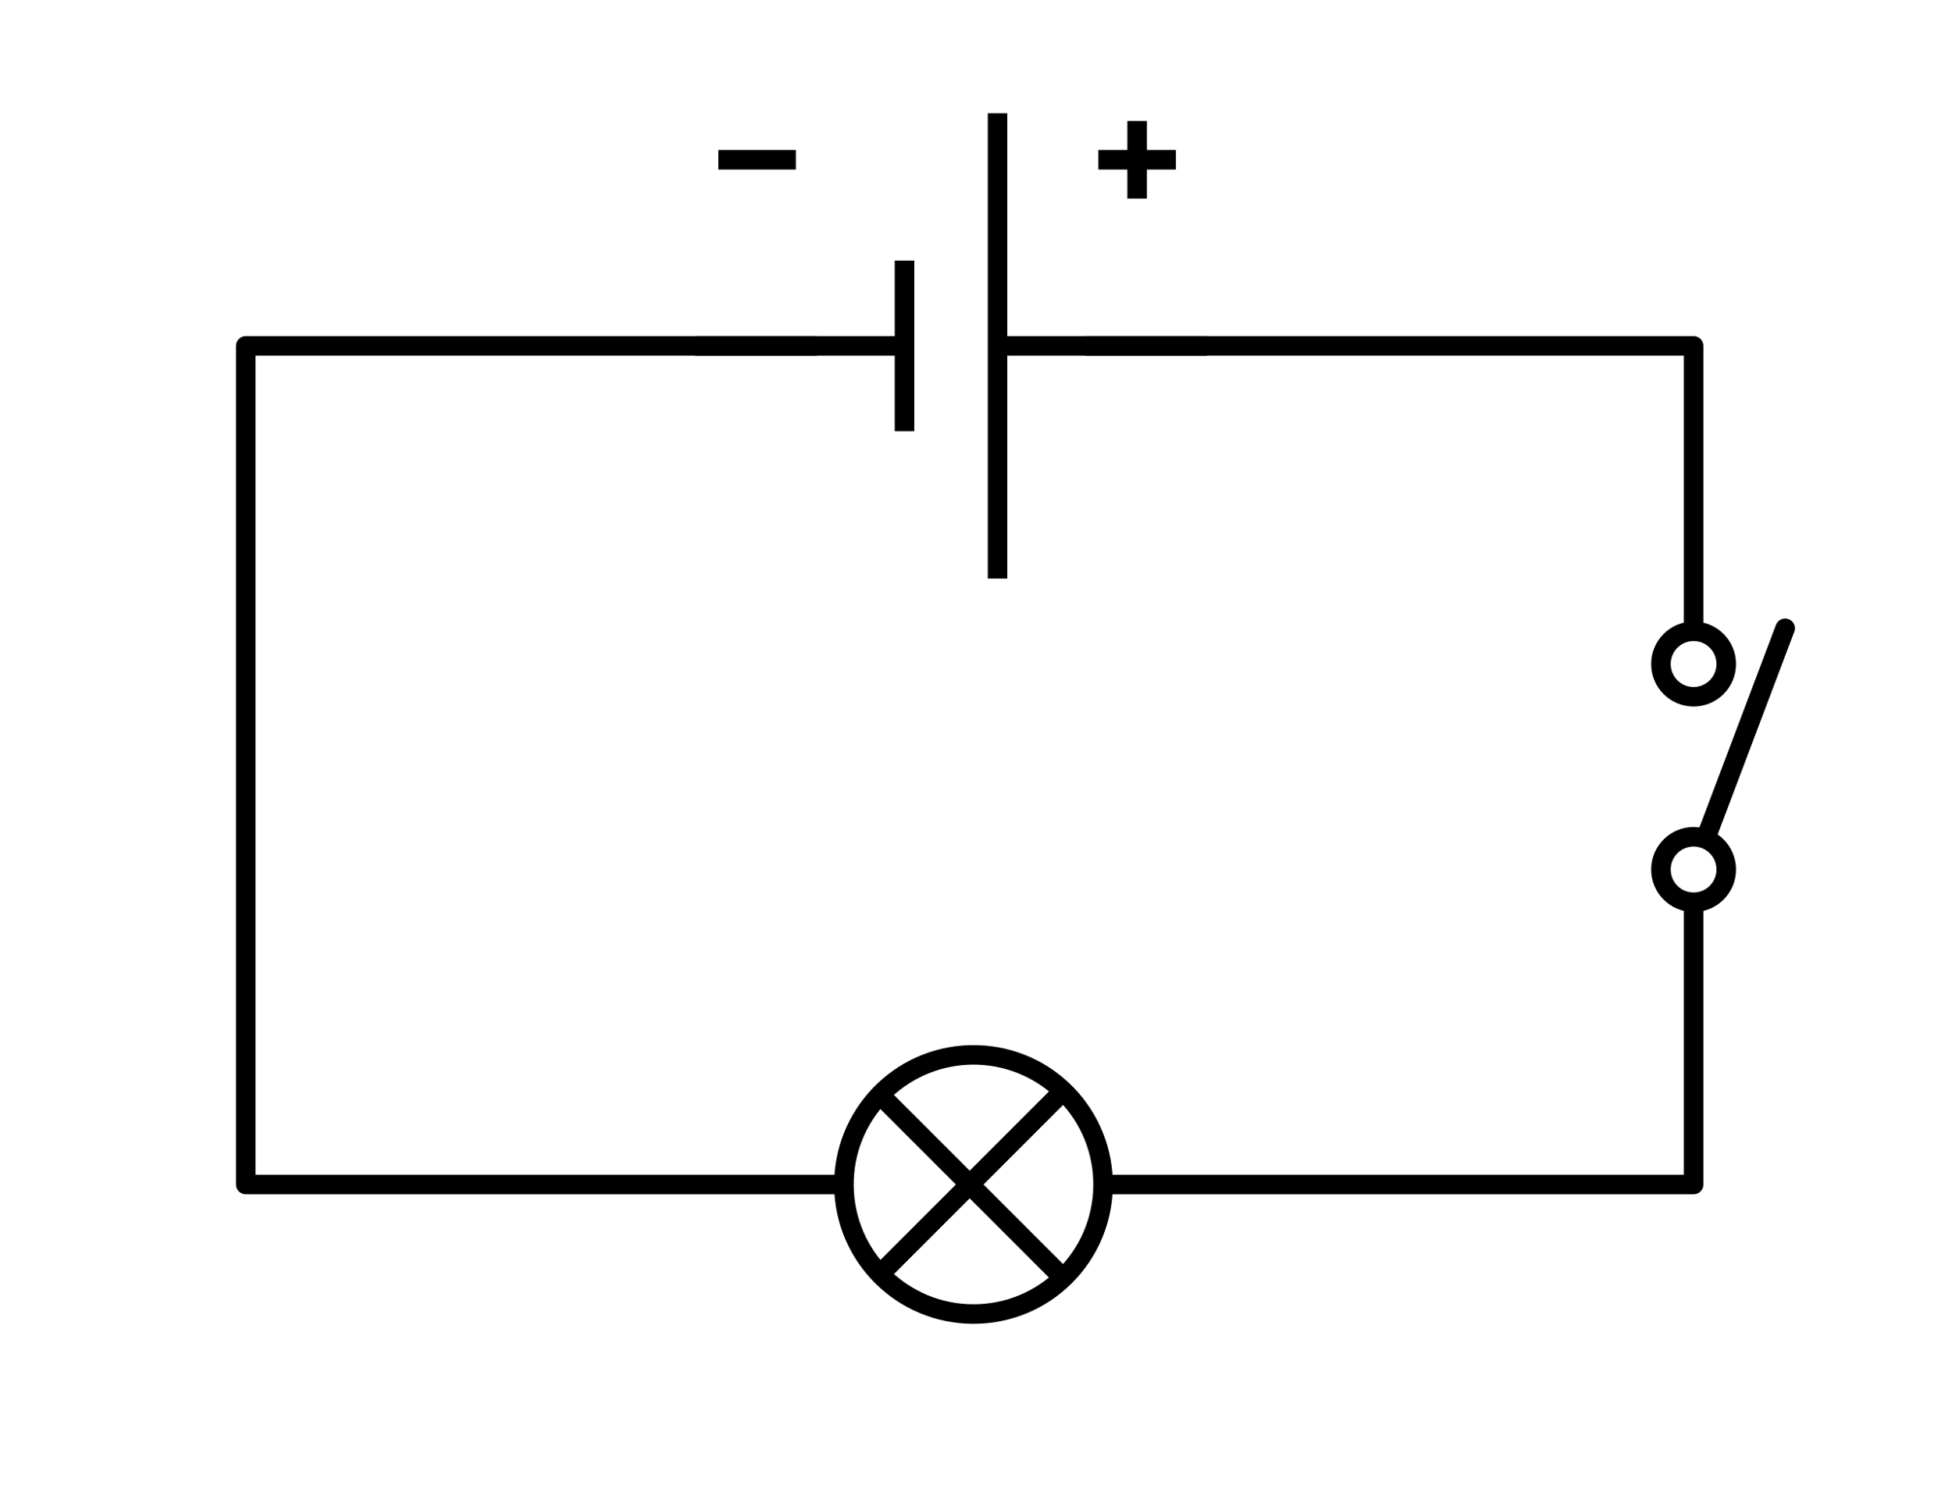
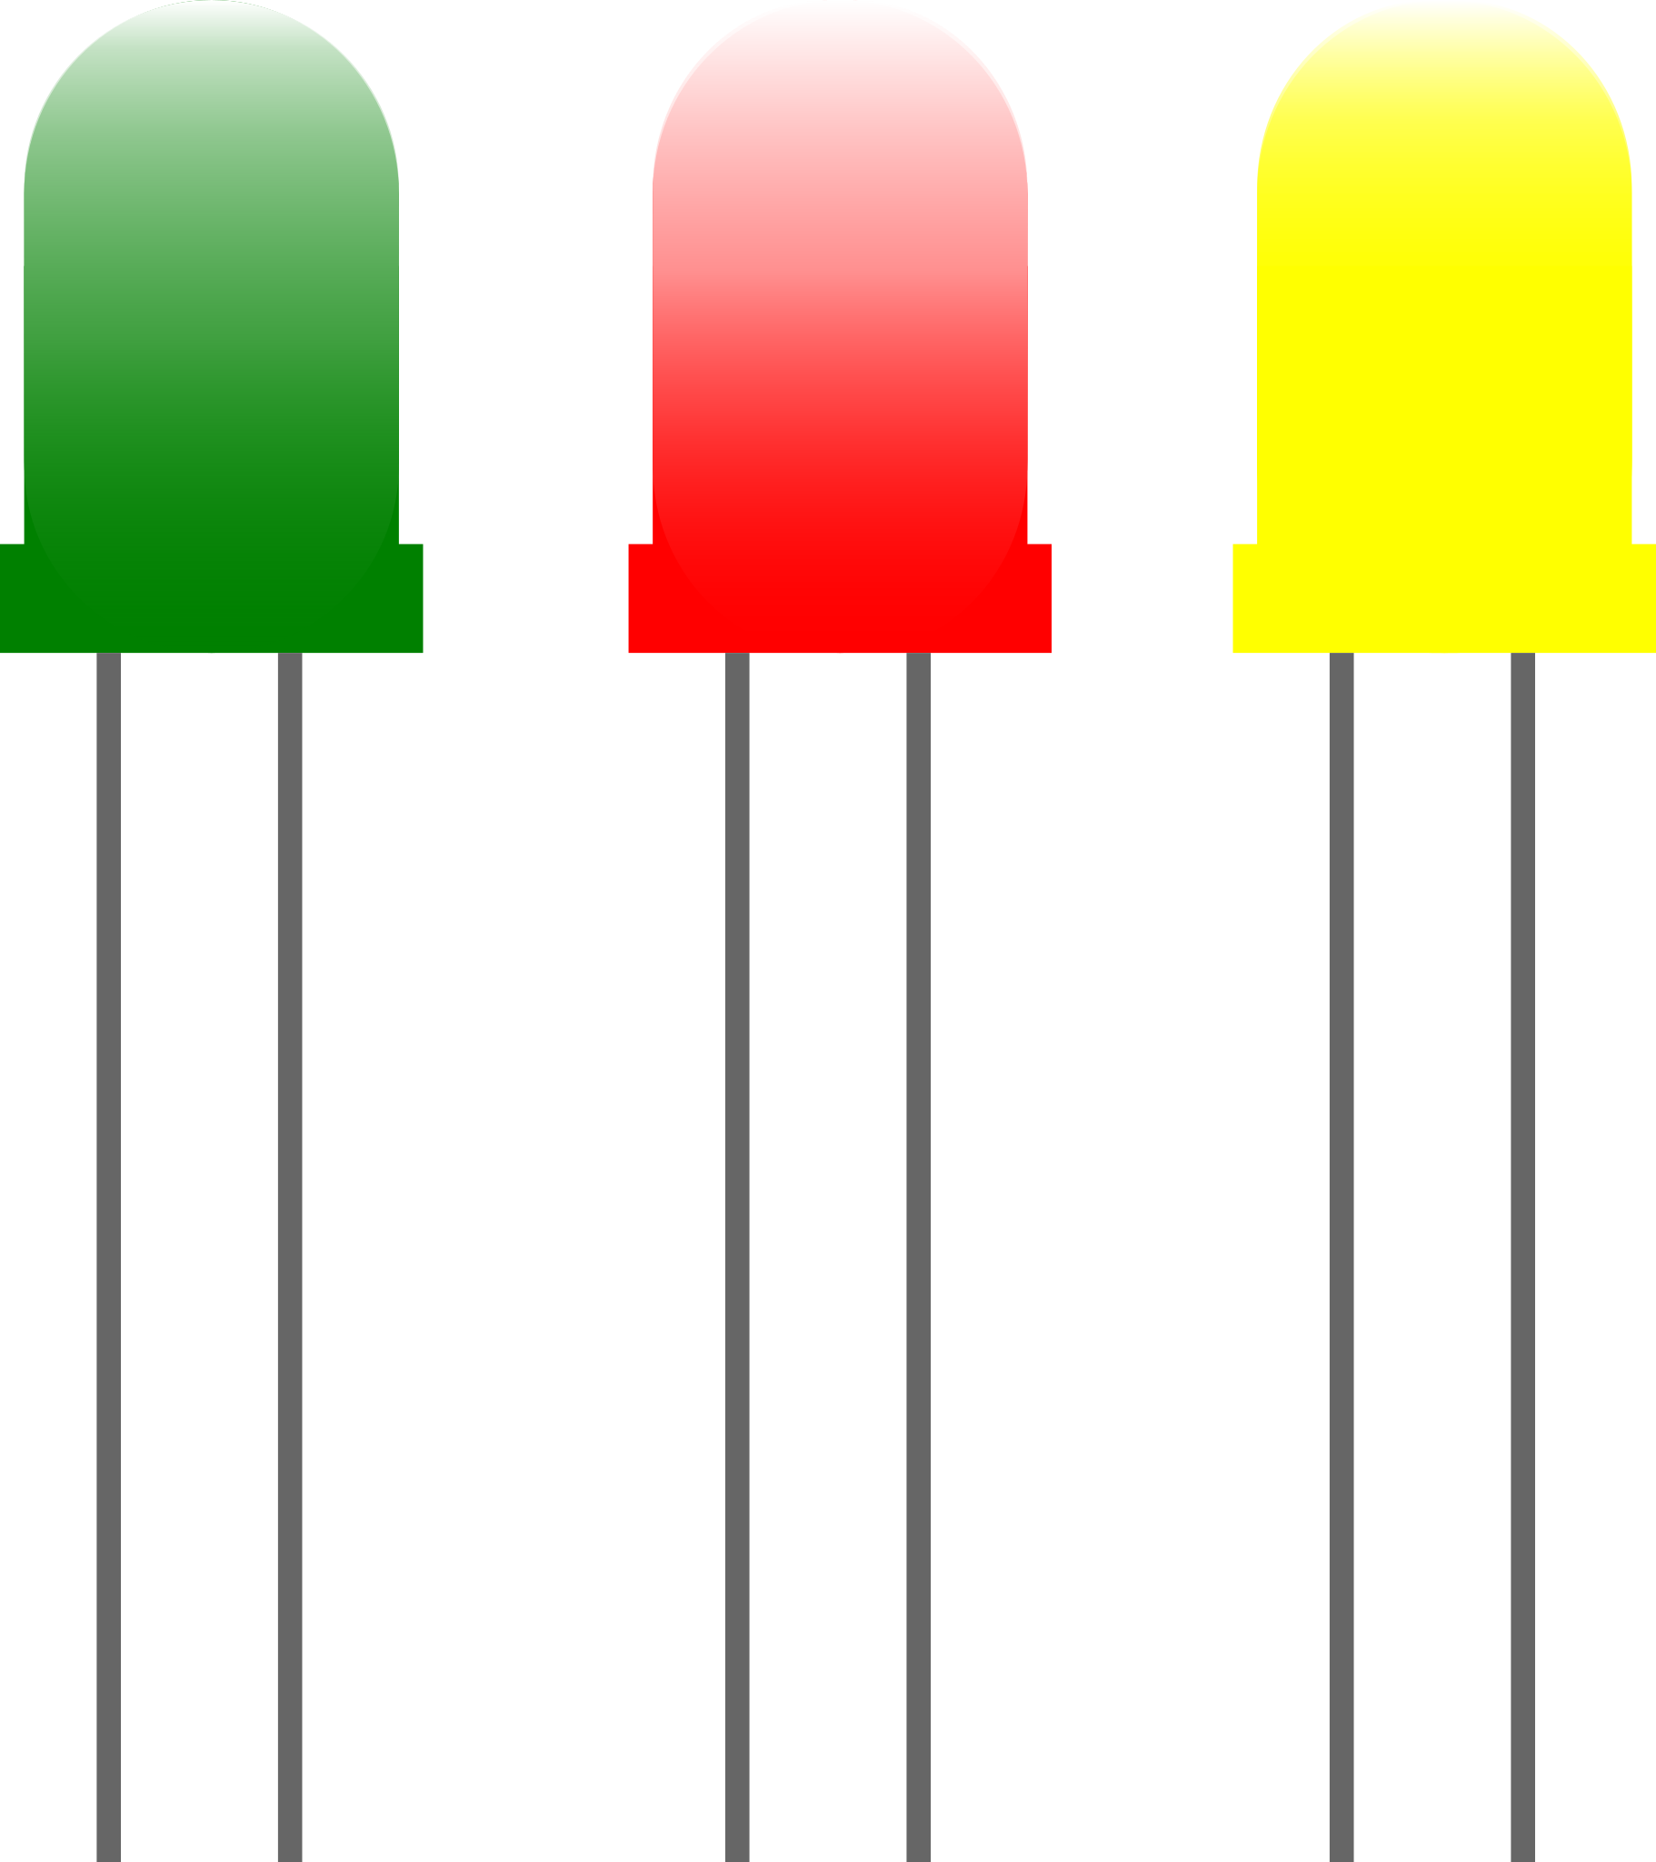
Key Vocabulary
Circuit
Polarity
Electricity
LED
Switch

Slide 70
Reflect
What did we do last week?
What did you make?
What tools did you use?
What skills did we learn?

Slide 71
Reflect
Does anyone know what a circuit is?
Does anyone know what materials we would need to make a circuit?
Where does the battery go?
Where does the LED go?
What material connects them?

Slide 72
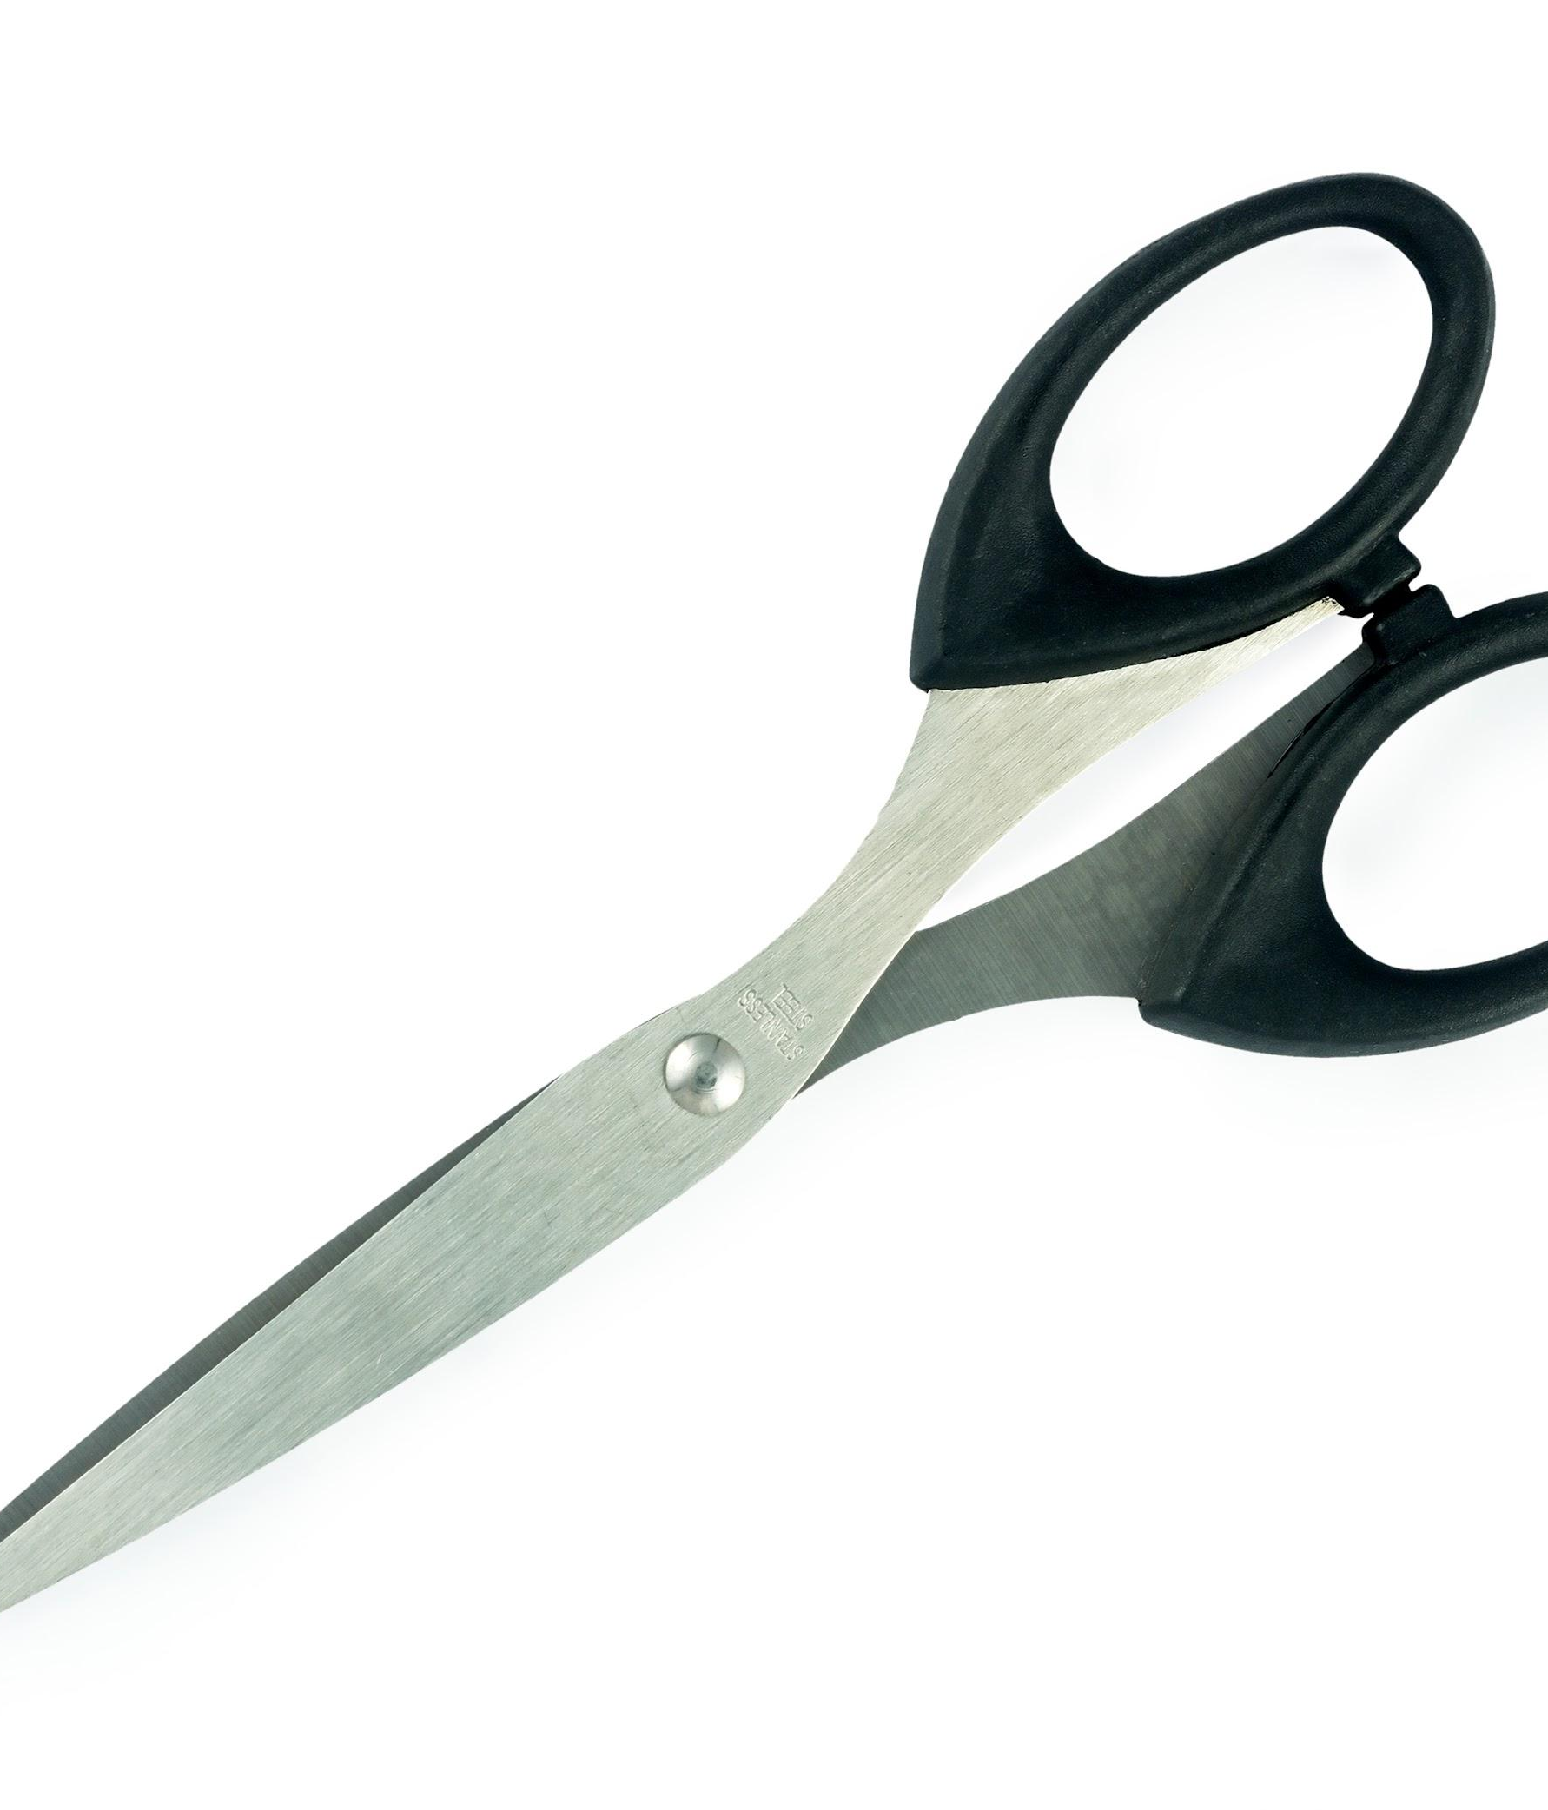
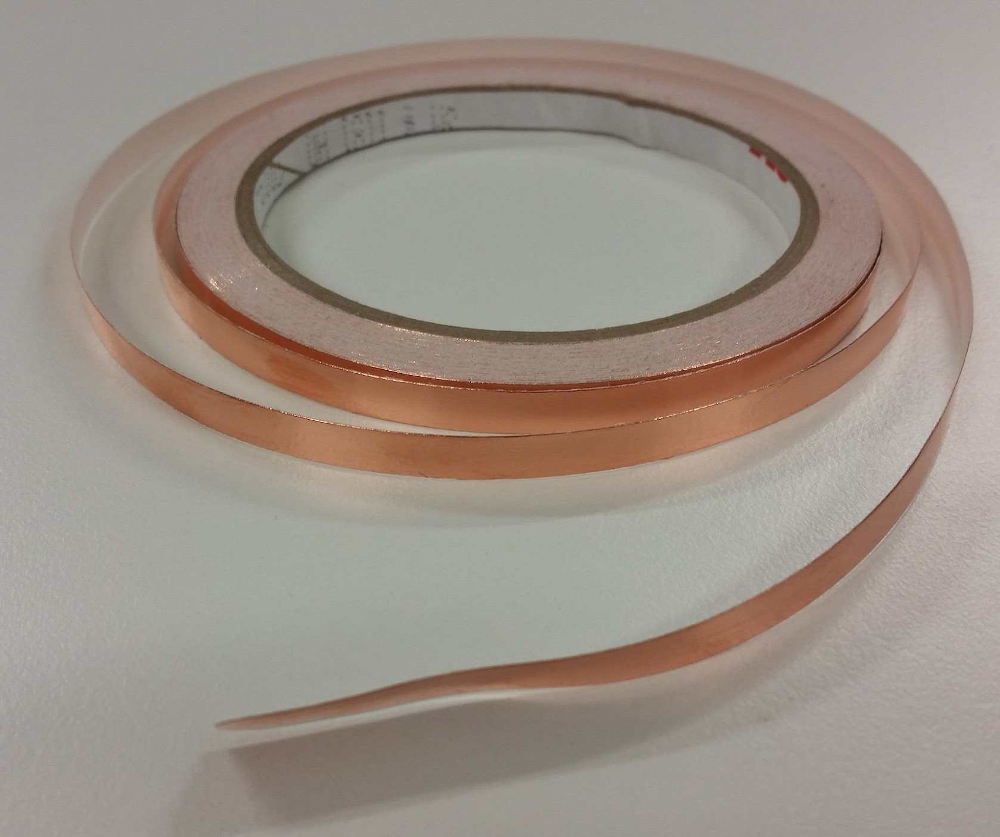
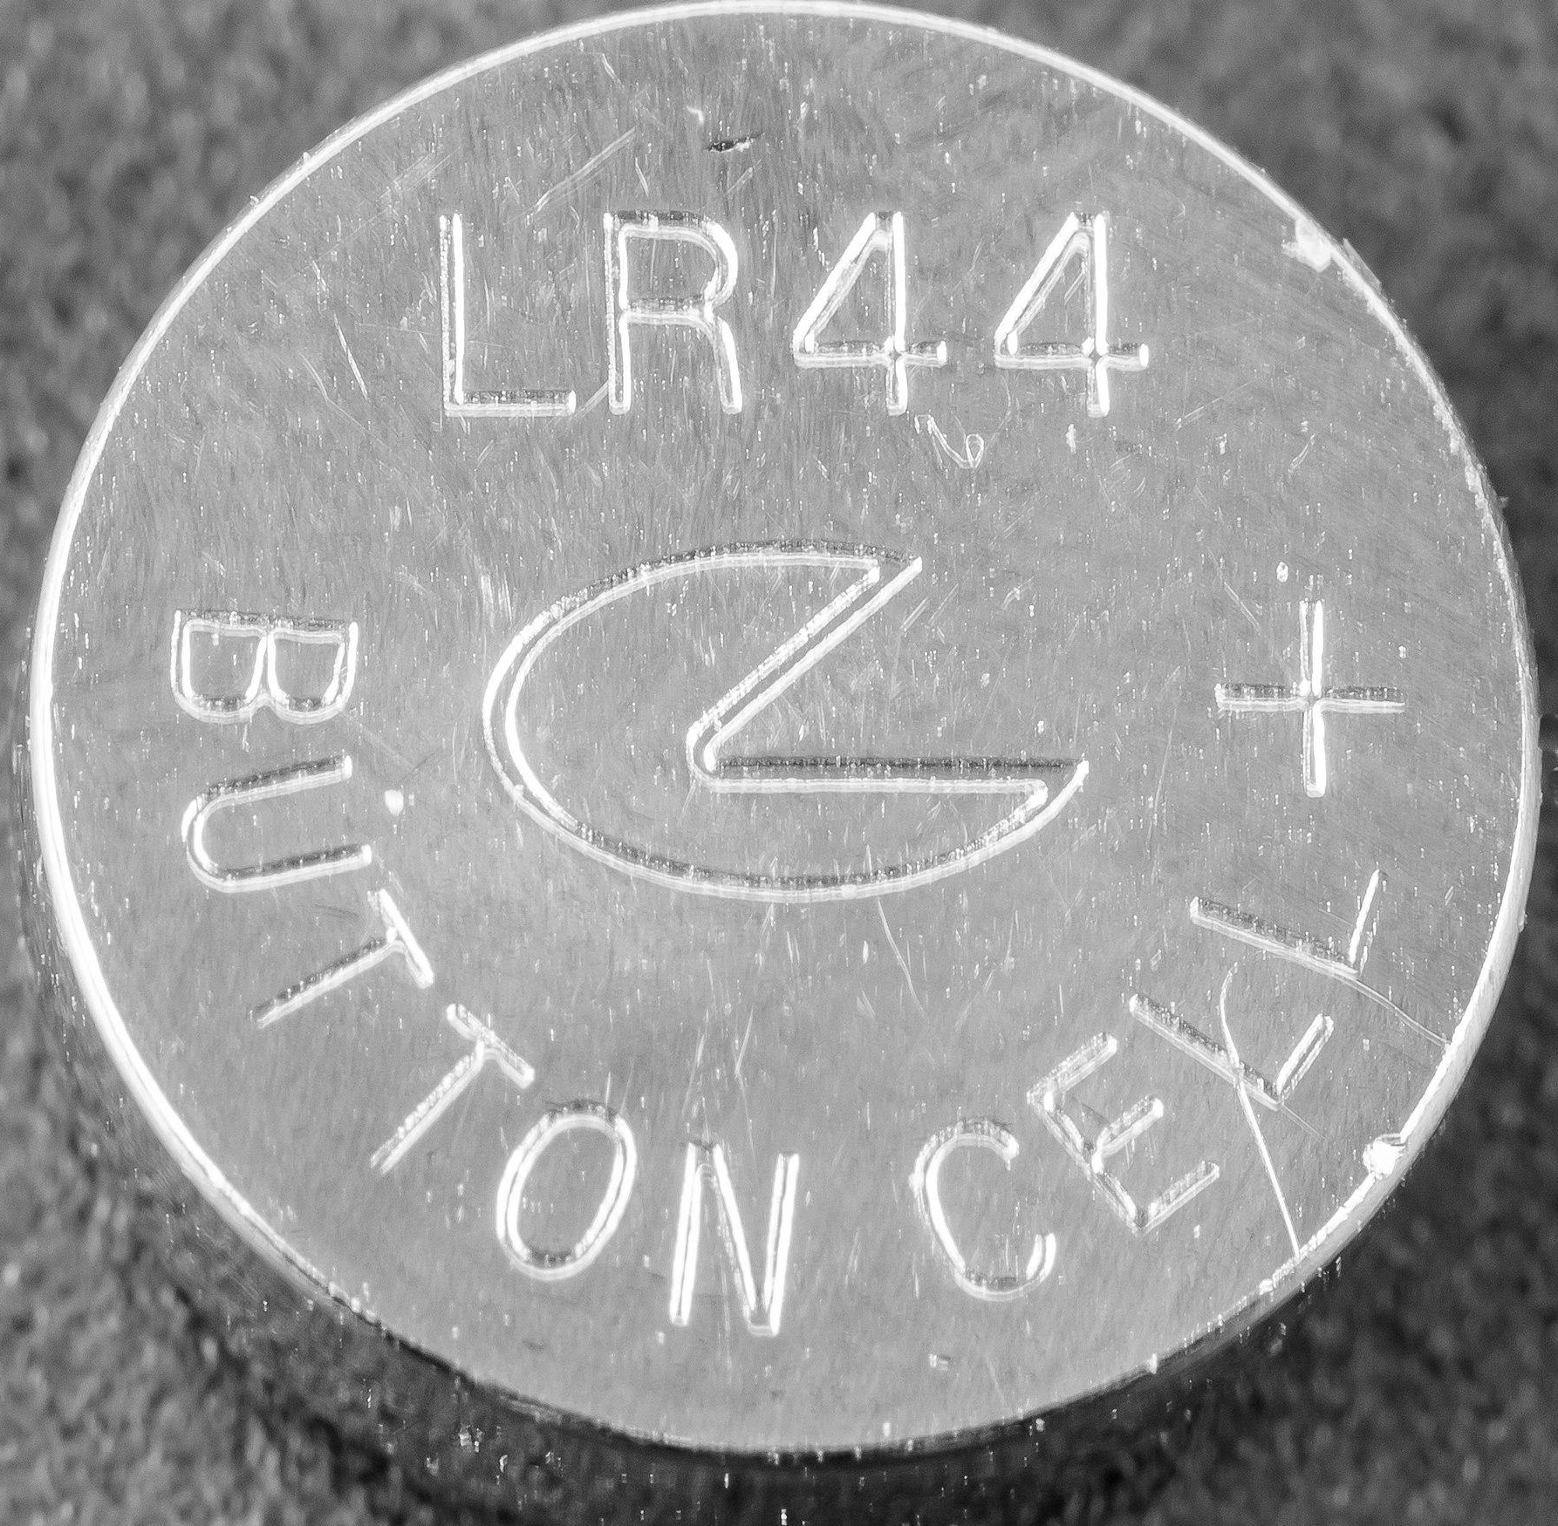
Materials you need
1 strip of conductive copper tape | 1 coin cell battery | 1 index card or small cardstock sheet cut into smaller pieces | 2 binder clips | 2 LEDs | Scissors | Tape

Slide 73
Activity
Follow the steps on the Circuit Steps handout
Build the circuit directly on top of the circuit printout.
BRAINSTORM
IDEAS
MAKE A
PLAN
START
IDENTIFY
THE
PROBLEM
PROTOTYPE
FAILS
MAKE YOUR
PROTOTYPE
ITERATION
IMPROVE
OR
FINALIZE
TEST YOUR
PROTOTYPE

Slide 74
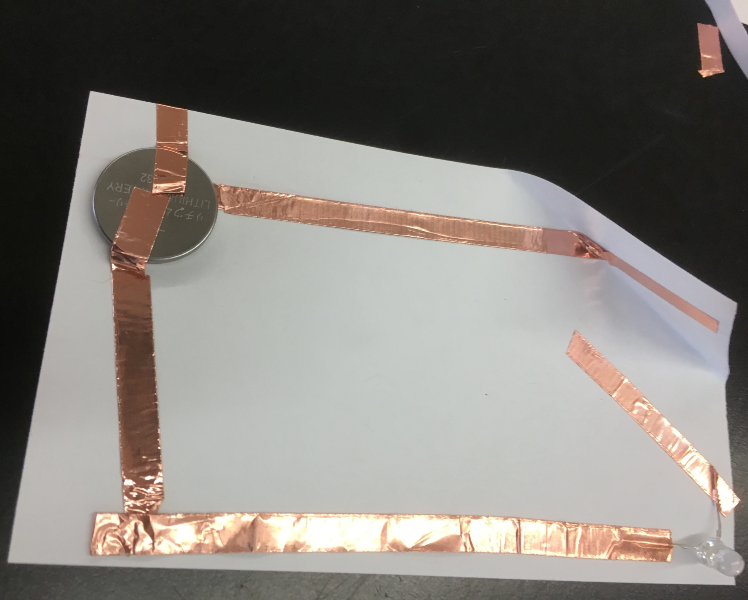
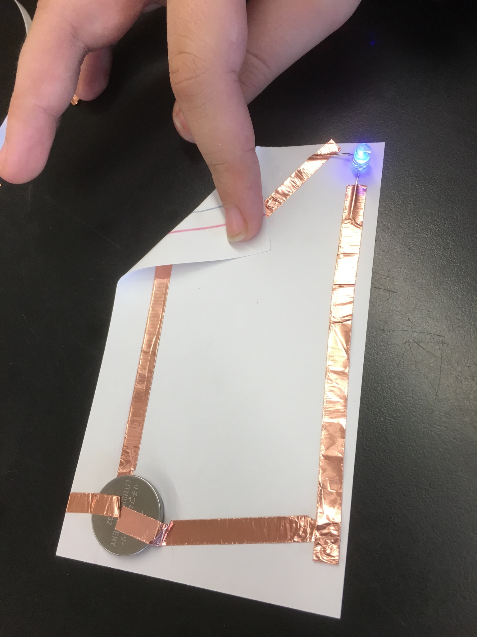
Problem Solving
LEDs are properly oriented (flip them)
The conductive tape is flattened all around
The circuit is not open
The batteries are working

Slide 75
After Activity Reflection
Demonstrate what you’ve made
Explain how the circuit works
Answer the prompts in your journals
“What steps of the EDP did you do today?”
BRAINSTORM
IDEAS
MAKE A
PLAN
START
IDENTIFY
THE
PROBLEM
PROTOTYPE
FAILS
MAKE YOUR
PROTOTYPE
ITERATION
IMPROVE
OR
FINALIZE
TEST YOUR
PROTOTYPE

Slide 76
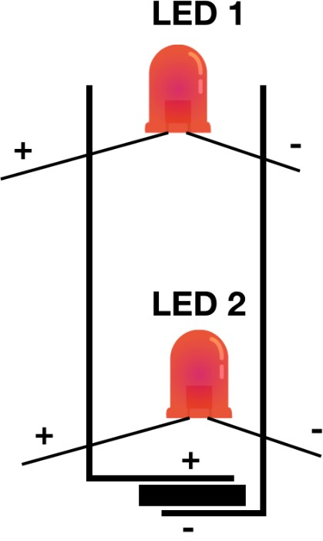
LED GREETING CARDS
70 minutes

Slide 77
Key Vocabulary
LED
Circuits
Battery
Card

Slide 78
Intro
What did we do the last time we met?
What did we make?
What tools did we use?
What materials did we use?
What is a circuit?
What is polarity?

Slide 79
Examples of Activity

Slide 80
Materials you need
LEDs
Coin cell batteries
Copper tape
Colored paper
Markers/colored pencils
Other materials to decorate
Scissors

Slide 81
Activity
Fold a piece of cardstock paper in half.
Decorate the card with the design you want.
On the inside or other side of the card, draw the circuit in pencil and plan where the LEDs are going to be.
Decorate the card before making the circuit with the copper tape, batteries and LEDs.

Slide 82
Activity
5. Poke 2 holes in the card where the LED legs will slide through.
6. Put the LED in and bend the legs 90 degrees so that they fix the LED on the paper.
7. Lay the copper tape down. Add the battery and tape it down.

Slide 83
Reflection
What did you make?
How did you make it?
What tools did you use? How did you use them?
How might you use them in the future?
What was challenging? What was easy?
Can you think of anything else you can create with LEDs?
BRAINSTORM
IDEAS
MAKE A
PLAN
START
IDENTIFY
THE
PROBLEM
PROTOTYPE
FAILS
MAKE YOUR
PROTOTYPE
ITERATION
IMPROVE
OR
FINALIZE
TEST YOUR
PROTOTYPE

Slide 84
MOTORS
1.5 hours

Slide 85
Reflect
?
What we did we do last time in Maker’s Club?
What tools or materials did we use?
What did we make?
?
?

Slide 86
Let’s use our motors!
Connect your motor to your battery.
How can we make this motor move? What can we attach to build a structure?

Slide 87
Materials you need
Motors
AA batteries
Materials to make robot, such as
paper cups and plates
popsicle sticks
pipe cleaners
googly eyes
pompoms

Slide 88
Build a moving bot!
Use your motor and other materials to make a robot or structure that moves.
Work for 15 minutes, then we will share with the group!

Slide 89
BRAINSTORM
IDEAS
MAKE A
PLAN
IDENTIFY
THE
PROBLEM
START
PROTOTYPE
FAILS
MAKE YOUR
PROTOTYPE
ITERATION
IMPROVE
OR
FINALIZE
TEST YOUR
PROTOTYPE

Slide 90
Share your designs with the club!
?
What worked well during this activity?
What didn’t work so well?
How did you fix what didn’t work
How could you use a motor in a final project?
?
?
?

Slide 91
Reflect in your journal
After looking at the engineering design process, what steps did you use today?
What actions did you take?
BRAINSTORM
IDEAS
MAKE A
PLAN
START
IDENTIFY
THE
PROBLEM
PROTOTYPE
FAILS
MAKE YOUR
PROTOTYPE
ITERATION
IMPROVE
OR
FINALIZE
TEST YOUR
PROTOTYPE

Slide 92
FINAL PROJECT: Project Planning
1 hour

Slide 93
Key Vocabulary
Sketching
Prototype
Iteration
Solution
Real-world problem

Slide 94
Materials
Journals
A3 sheets of paper
Pencils
Rulers

Slide 95
How a 3D printer works?

Slide 96
Activity: Sketch
Sketch your final project, illustrating as many details as possible
Sketch does not need to be a neat diagram

Slide 97
BRAINSTORM
IDEAS
MAKE A
PLAN
IDENTIFY
THE
PROBLEM
START
PROTOTYPE
FAILS
MAKE YOUR
PROTOTYPE
ITERATION
IMPROVE
OR
FINALIZE
TEST YOUR
PROTOTYPE

Slide 98
FINAL PROJECT: Prototype 1
1.5 hours

Slide 99
Key Vocabulary
Thermoplastics
Material
Properties
Change of state

Slide 100
Materials
Cardboard
Wooden blocks
Glue sticks
Play-Doh
Foam
Tools:
Glue gun
Scissors
Cardboard cutters
TinkerCAD

Slide 101
Activity
Explore the materials
See how each material may benefit the prototype you are about to build

Slide 102
Reflection
What did you make today?
What material(s) did you choose?
Why did you choose that material?
What do you like about your design?
What else do you have to do? Or if they are done, What would you change in the second prototype?
BRAINSTORM
IDEAS
MAKE A
PLAN
START
IDENTIFY
THE
PROBLEM
PROTOTYPE
FAILS
MAKE YOUR
PROTOTYPE
ITERATION
IMPROVE
OR
FINALIZE
TEST YOUR
PROTOTYPE

Slide 103
FINAL PROJECT: Prototype II
1.5 hours

Slide 104
Key Vocabulary
TinkerCAD
3D Design
Prototyping
3D Print

Slide 105
Materials
Laptops
Mice
All materials from
Prototype 1
Tools:
TinkerCAD
Cheat sheet
All tools from Prototype 1

Slide 106
Intro Reflection
What did you make last time we met?
Did you finish your prototype?
What do you have left to do?
BRAINSTORM
IDEAS
MAKE A
PLAN
START
IDENTIFY
THE
PROBLEM
PROTOTYPE
FAILS
MAKE YOUR
PROTOTYPE
ITERATION
IMPROVE
OR
FINALIZE
TEST YOUR
PROTOTYPE

Slide 107
Activity
Pick up where you left off
Do you remember what the parameters for a successful print are? Maximize surface area, orientation, and overhang.
After review and discussion:
Export it as an .svg file.
Ask for the thumb drive:
Name the file (Your Name_final project) and put it on the drive

Slide 108
FINAL PROJECT: Final Poster
1.5 hours

Slide 109
Key Vocabulary
Prototype
3D design
Circuits
Iteration
Process

Slide 110
Materials
Poster board
All projects made in the Maker Club
Tape
Markers
Tools:
Glue gun
Optional:
Batteries (for motors)
Mixed decoration materials

Slide 111
Activity
Today is the day!
Show off your amazing projects
Ready!

Slide 112
Insert photos of the
students throughout the Maker Club sessions.

Slide 113
FINAL PROJECTS
Brainstorm ideas for the final projects, discuss their feasibility, and create spec sheets detailing students’ ideas and how they will make their projects.

Slide 114
Icons (can be resized and can change colors)

Slide 115
Maker Program Icons (can be resized and can change colors)
One Sheet of Paper
Journal Making
Intro to 3-D Printing
Wooden Blocks
TinkerCad
Lights
Circuits
LED Greeting Cards
Final Projects
Reflect
Write in Journal
Share Ideas
Motors

Slide 116
Video Timers
More timers in the same style available on youtube through Adam Eschborn
https://www.youtube.com/channel/UC53vOmOKmI5IFopx7TbRsWw

